Slide 1
Alaska POLST Basics for Health Care Professionals: Hospital and Emergency Department Use
Ursula McVeigh MD
Executive Medical Director, Hospice and Palliative Care Providence Medical Group Alaska (PMGA)
DHS POLST Education Workgroup
Notes:
These slides are offered freely for use by anyone furthering POLST education in Alaska

Slide 2
Created in Collaboration with the DHSS POLST Education Workgroup
Presenter has no financial disclosures
This and other LTC POLST programming made possible by: Civil Money Penalty (CMP) Fund Grant Program from the Alaska Department of Health & Social Services
Special thanks to:
Providence Alaska Foundation for their partnership with ASHNHA to secure funds on behalf of this program.

Slide 3
1. Understand the AK POLST program, form and Comfort One transition
2. Know the intended population and voluntary nature for POLST use
3. Know how the POLST form works:
4. Recommendations for acute facility policies and protocols for POLST
GOALS FOR TODAY

Slide 4
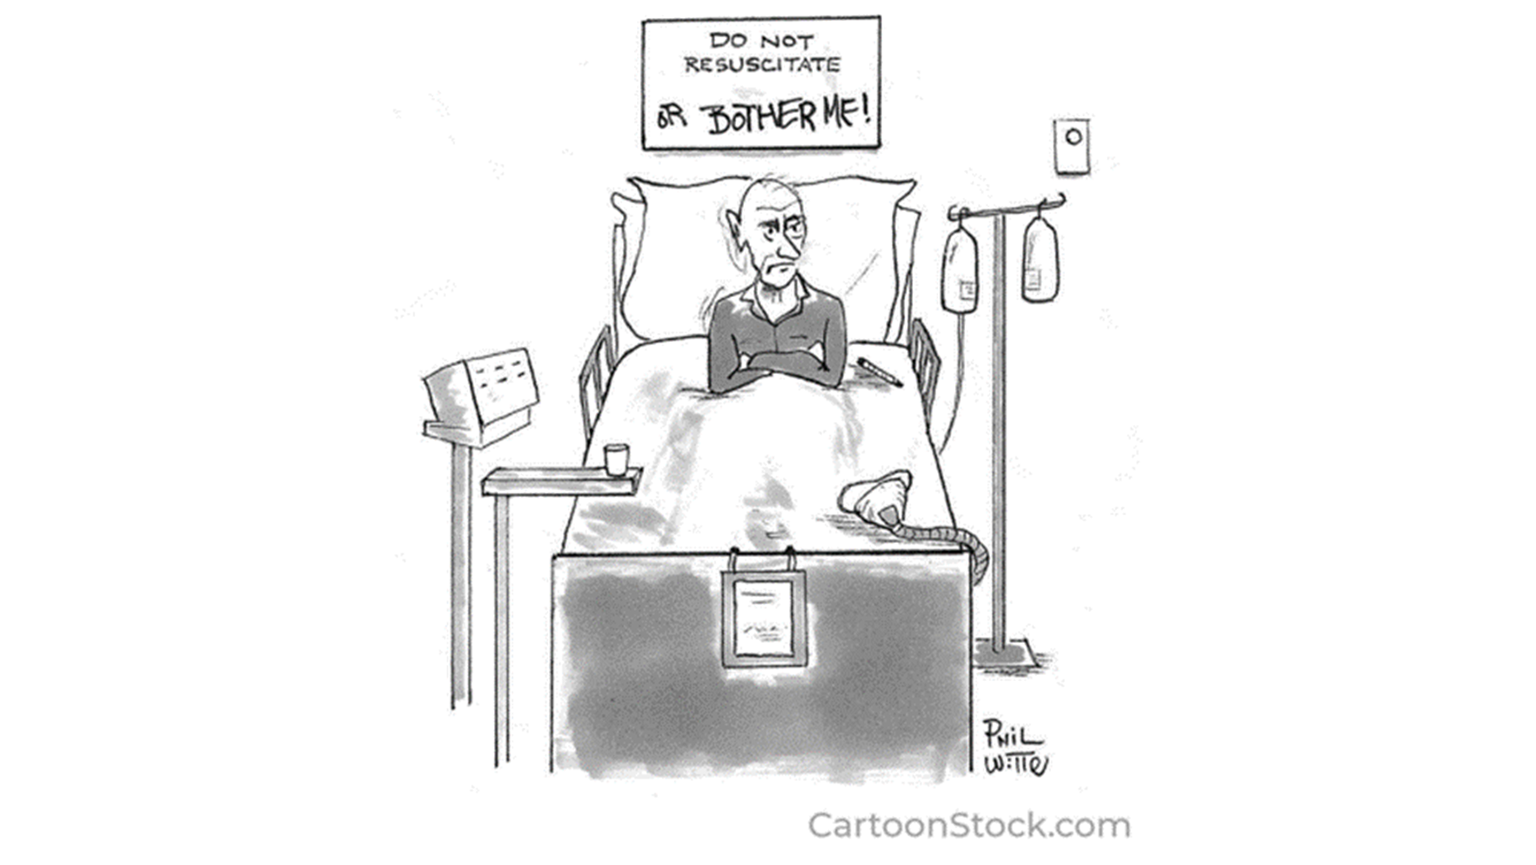
POLST is replacing Comfort One as the state-wide DNR order and now includes orders for other wishes…
Notes:
Patients facing serious illness have preferences and priorities that inform the care they want to receive. POLST is now replacing Comfort One as the state-wide DNR identification program and improves on the comfort one framework for allowing more details about spectrum of other wishes for pre-arrest emergencies

Slide 5
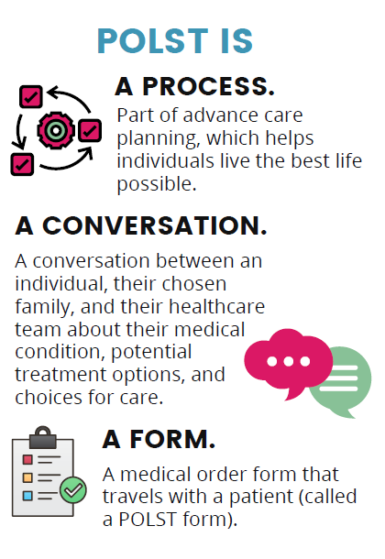
POLST BASICS
Notes:
We are here talking about the new Alaska POLST : as we do so we’ll be coming back to these basic ideas central to what is POLST – more than a form, it is part of the process of advance care planning and the product of impactful conversations between a patient and their health care professional about their illness, goals and preferences for care when seriously ill and/or at the end of life.

Slide 6
THE PROCESS
National POLST polst.org
Notes:
Advance care planning is for every adult
Thinking about what is important & who is trusted to make decisions
Writing down what others need to know
Making sure everyone understands the plan- sharing, policies, training to ensure orders are honored
For healthy adults the standards of care is the best care possible- these standard emergency algorithms use all medically effective means to prevent death in unexpected medical emergencies.
But for people with serious illness and/or near the end of life- individuals may want to opt out of these standard protocols – to have limitations of treatment and end of life care plans that avoid use of aggressive treatments and machines.
Important to note that POLST does not replace advance directive- these are recommended for every adult and important to name who they want to make decisions for them if they can’t for themselves and to give guidance in those decisions for future, hypothetical medical events.
And for adults with serious illness, where anticipated medical events are expected as part of the natural course of their own illness, they may consider thinking in advance about these anticipated emergencies and define their wishes as actual medical orders for events now- and near future

Slide 7
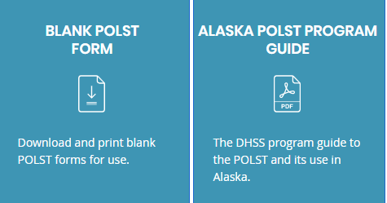
COMFORT One TO POLST Transition
POLST Form and Program Guide 2021
Comfort One will sunset
Both POLST and Comfort One remain legal
June 2022 DHSS will stop resupplying C1
Alaska POLST modeled after National POLST form
Alaska POLST should also replace the Alaska MOST form
AKPOLST.ORG
Notes:
Alaska Health Care Decisions Act of 2004 put into law the framework for a statewide DNR identification program and gave DHSS the authority to define this program through regulation. Comfort One was developed and now DHSS has passed through regulation the AK POLST program to replace Comfort One. Aside from a new form, the regulation also included a Reference Document that defines the laws and protocols required to be followed.
Comfort One forms will/should still be honored, but DHSS will stop resupplying Comfort One forms in June 2022. As POLST is a legal medical order now , it is required that all health care providers honor the POLST orders when presented, and it is rec to star adopting POLST and developing policies for use now.
Alaska POLST was modeled after the National POLST form- part of a 50 state consensus project that informed best practices and content for a state POLST form.
The Alaska Most form, though developed by a state task force, was never legislated as a state medical order and it’s appearance is very similar to POLST. But b/c it is not a legislated order, these are not medical orders that can be followed by EMS and there is not a protocol or liability coverage for health care professionals to honor these orders outside of it’s use as an in-facility order set. It is rec that for areas using MOST that they also transition MOST to using AK POLST instead.

Slide 8
“The POLST form is intended for patients with advanced illness or frailty where accurate predictions cannot be made but death is likely in the foreseeable future.”
Anyone with a DNR ordered in the ED/Hospital
Would you be surprised if this individual died in the next 1-2 years?
Does the patient have a disease process that is in an advanced stage?
Is the patient experiencing a significant decline in health (such as frequent aspiration pneumonias) ?
Would this person be potentially harmed by, or their overall condition worsened by, aggressive, invasive measures?
WHO SHOULD BE CONSIDERED FOR A POLST?

Slide 9
WHO CAN FILL OUT A POLST FORM?
Patient or Legal Decision Maker
parent
Notes:
Durable Power of Attorney for HealthCare:
This document assigns health-care decision making authority to person’s chosen agent.
Can only be appointed by the individual.
Most legal/BEST way to choose agent
If no documents exist, individual can name a “trusted decision maker” (TDM) verbally to a health care provider.
If neither of these exist, follow the hierarchy in state statute re: who can act as surrogate
Important for people to understand what happens when surrogacy is assigned from the hierarchy without an active choice by the individual:
All members of one class must either:
Vote on who will make decisions
Make decisions by consensus (or majority rule if unable to come to consensus)
Guardians don’t actually sign POLST but may offer a non-objection to the physician’s recommendation (assent or non-opposition) : formal ‘non-opposition letter” and physician may sign POLST indicating guardian assent.

Slide 10
Alaska law requires all healthcare professionals to follow POLST Orders
WHO CAN (MUST) HONOR POLST?
All health care professionals, when presented:
(includes EMT’s, first responders, and health care providers and clinicians in all settings)
Shall comply with POLST orders
Are provided immunity from civil or criminal liability
Law covers how to handle disputes:
Patient or legal decision maker can:
VOID a POLST verbally to a health care professional
CHANGE a POLST by completing a new form signed by a physician
Nathan Gray, M.D. inkvessel.com
Notes:
These parameters all outlined in reference document so are legally defined in how to use POSLT
Patients or surrogates can modify or void a POLST form, but modification required new orders be signed by a physician, but to void they can void at any time by informing any health care professional- ie patient or legal decision maker can void a POLST with EMS in the emergency
If dispute arises regarding existing treatment orders on a POLST the reference guide describes:
EMS: clarify understanding and contact On-Line Medical Control. If conflict continues to exist, transport to a hospital where there is more time to address conflict
Health Care Facilities and Organizations: follow your policy regarding surrogate/health care decision-making

Slide 11
The Conversation
Heath Care Professional & Legal Decision Maker
Preparer: any member of health care team with POLST training and skill
Physician signs - medical order
Next webinar:
The Art of the POLST in Skilled Nursing Facilities
Feb 8, 12:00PM
Nathan Gray, M.D. inkvessel.com
Notes:
While the rest of the talk will focus on what the POLST orders mean and protocol for use in emergencies, it’s worth emphasizing that the POLST is the end product of a important conversation- the webinar on Feb 8th will cover POLST conversation skills.
The AK POLST, at this time, is required to have a physician signature to be an active medical order. This is because the AK Statute informing this program defines DNR as a physician order. Although it is best practice to allow advance practitioners to sign POLST orders, when POLST was being developed DHSS had a lawyer review and because DNR was defined as a physician’s order in the statute, the regulation must also require this, and to allow APPs to sign requires a statute addendum that is passed through legislation. There is wide consensus that this is important and appropriate to pursue but was not possible to addend the statute at this time of POLST implementation . So for 2022, we are beholden to the 1996 statute definition of DNR and POLST, was also true for Comfort One, requires a physician signature. This does not require that the physician have the direct conversation with the patient, an APP or other member of the health care team can assist the patient in completing the POLST.

Slide 12
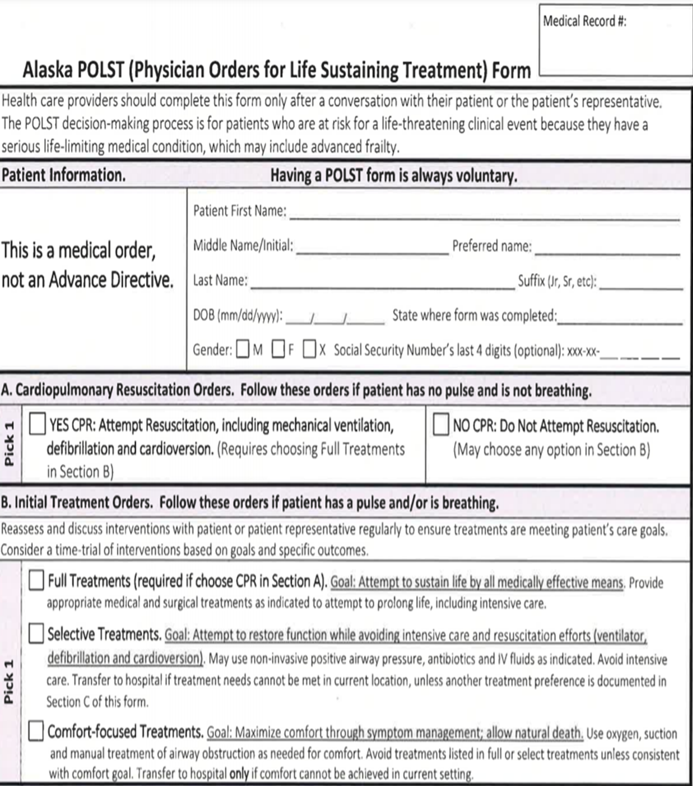
HIGHLIGHTS OF THE ALASKA POLST FORM
MEDICAL ORDER, not advance directive:
Transferrable, portable, and consistently interpreted
A.”CPR orders”
Preference for care when death is imminent
(Full Code vs DNR)
B. ”Initial Treatment orders”
Preference for level of care during distress /illness when not in cardiopulmonary arrest:
“Where do they want/accept to be cared for?”
ICU with full interventions
Hospital but no ICU
Home or LTC i.e. “in place”

Slide 13
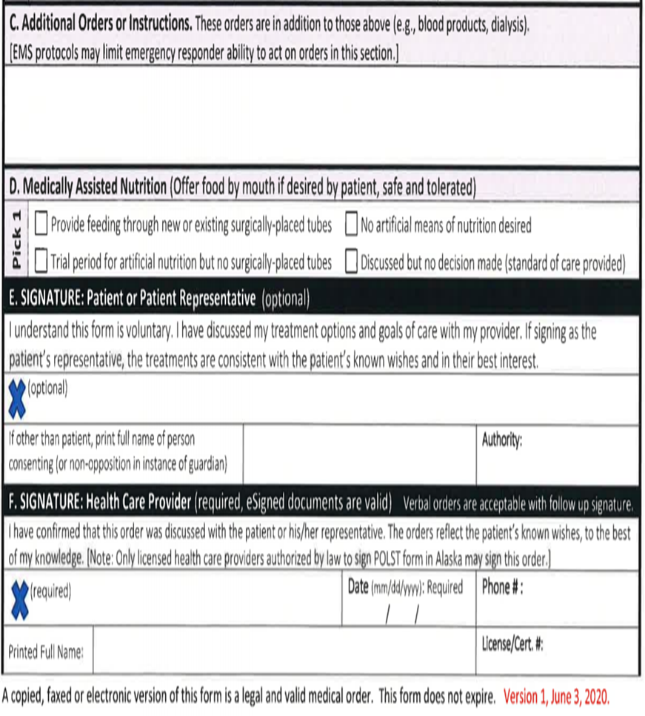
HIGHLIGHTS OF THE ALASKA POLST FORM
“Additional orders” section used to individualize orders:
Exceptions to Section B Orders
e.g. want Selective Treatment but no NIV
Contains preference for medically-assisted nutrition and hydration
Patient/surrogate signature is optional but recommended
MD/DO signature required per AK state legislation
verbal order confirmed by any clinician able to accept verbal orders
V.O rec'd by N.Practitioner
Notes:
Verbal orders acceptable with f/u signature.
Can be signed by RN/ANP/PA documenting the verbal order from the physician and EMS instructed that verbal orders are active orders to be followed.
The physician signature confirms that conversation about goals/outcomes has occurred (even when someone else has had it) and confirms basis for decision, if made with surrogate

Slide 14
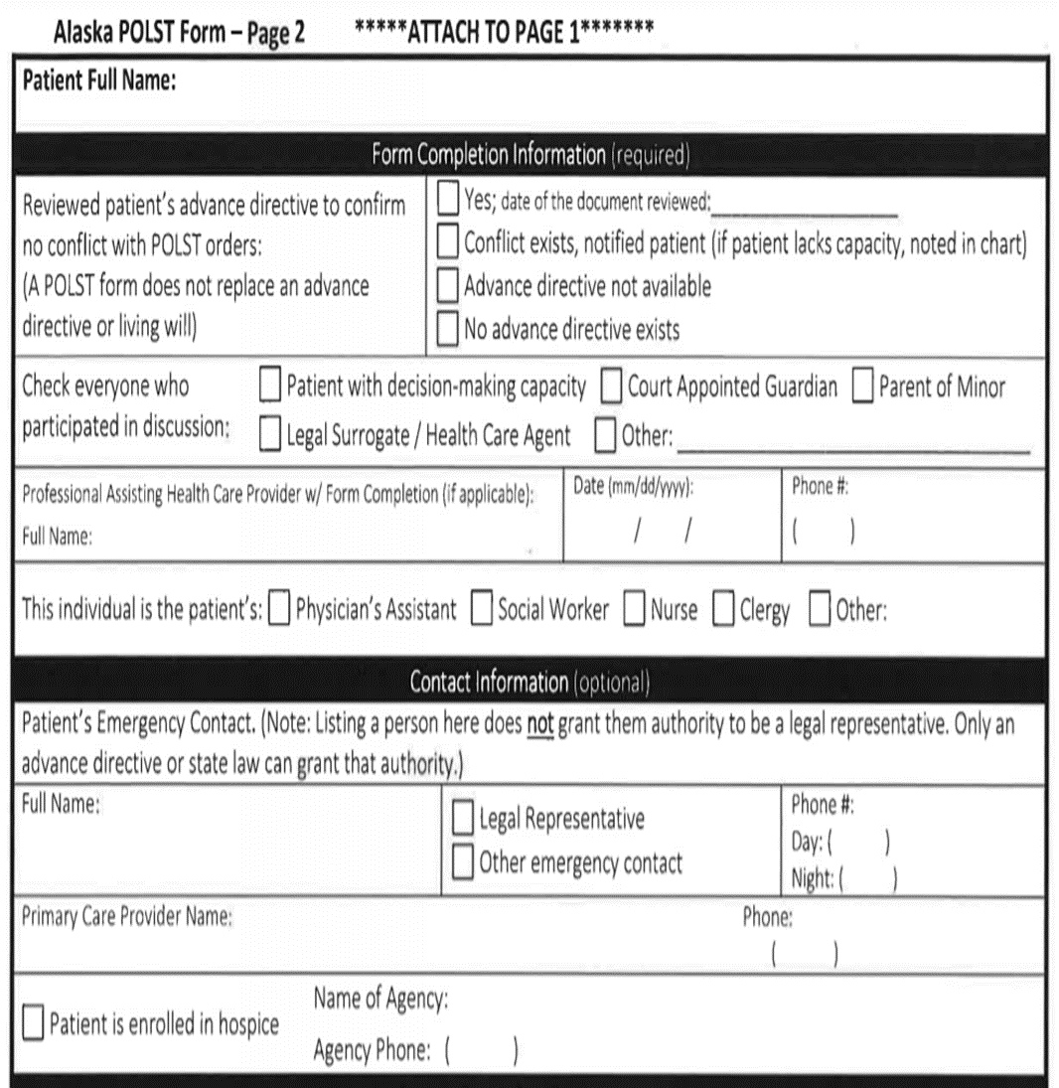
HIGHLIGHTS OF THE ALASKA POLST FORM
Form completion information (required):
Confirms that process involved:
Identifies members of healthcare team who assisted in conversation/completion and with whom
Contact Information: (optional)
Confirms names/contact information for support people
ANP,DNP
Practitioner

Slide 15
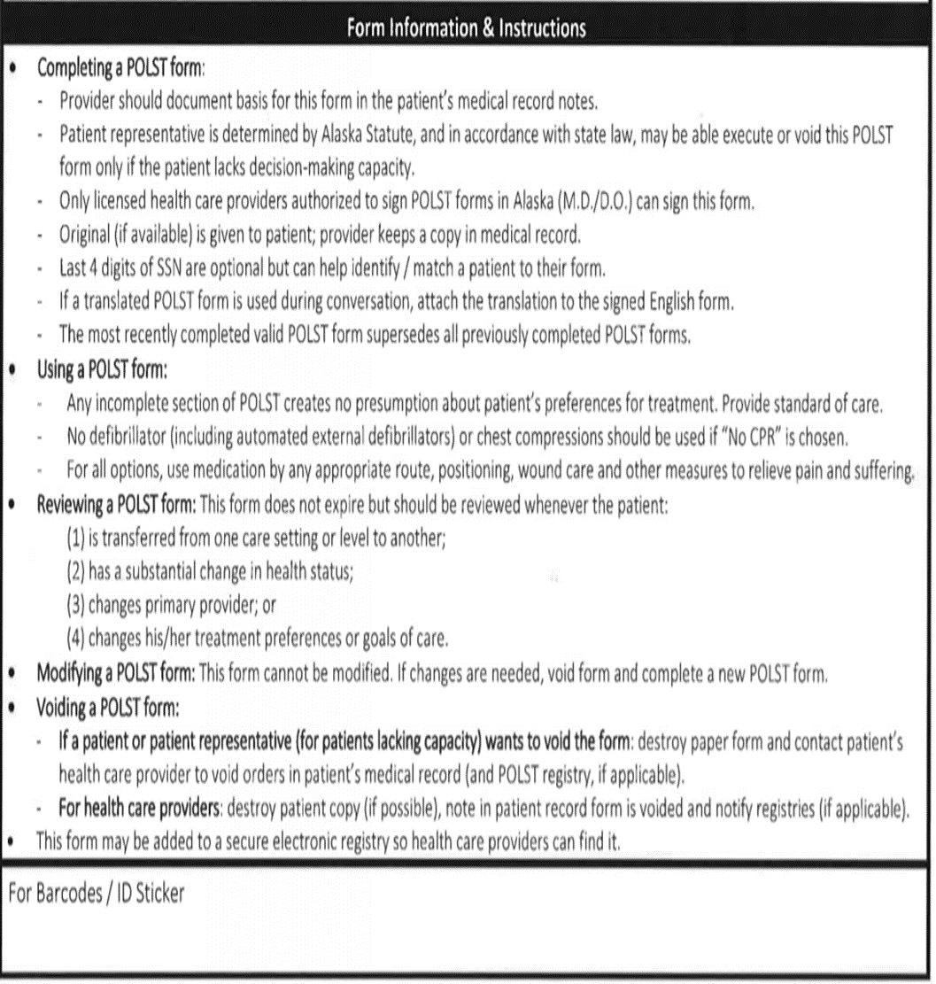
HIGHLIGHTS OF THE ALASKA POLST FORM
Instructions for completing, honoring, modifying or voiding the POLST
Notes:
Please READ -
95% of everything you need to know about POLST is found somewhere on the form itself

Slide 16
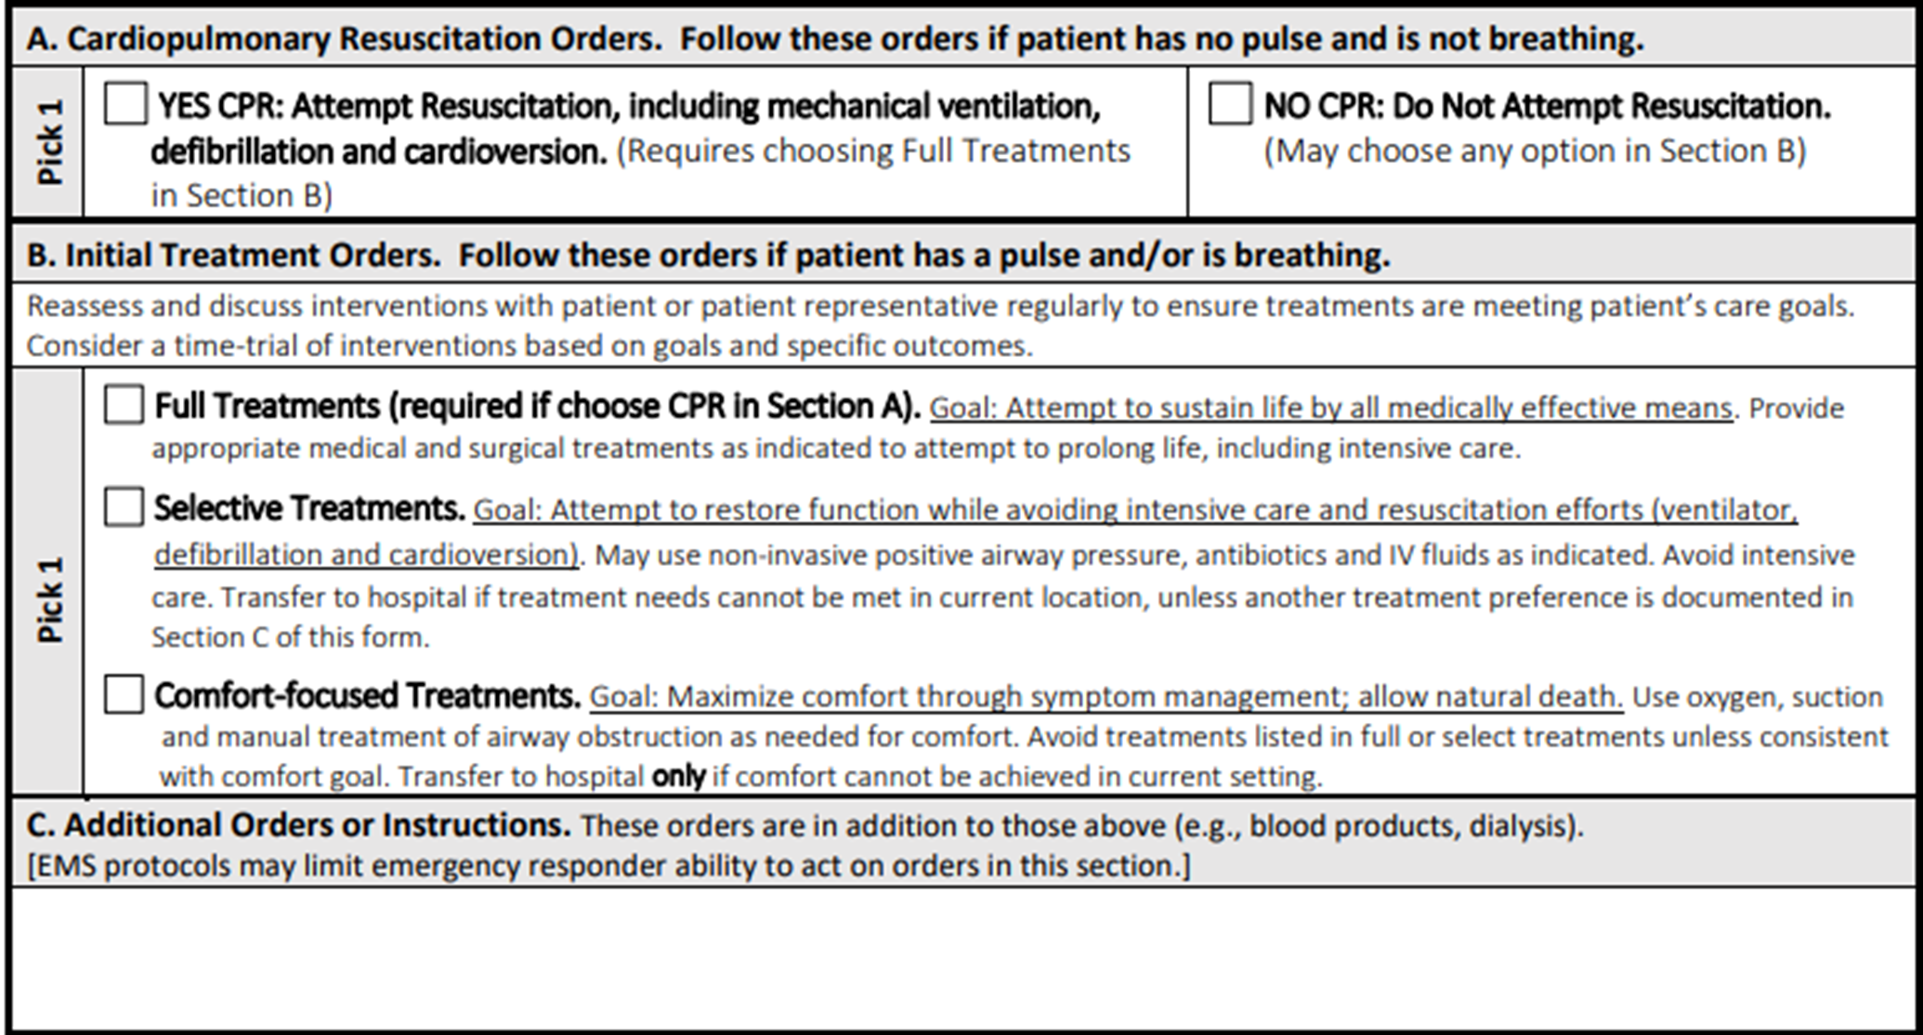
INTERPRETATION OF POLST ORDERS in Emergency Response and for Translating into Facility Orders
Notes:
Now we’ll run through how to translate POLST orders in an emergency and on admission to the hospital
The two main sections, A and B, specific wishes in instance of cardiopulmonary arrest (patient has no pulse and is not breathing) and in non-arrest emergencies (patient has a pulse and /or is breathing

Slide 17
Section A. Cardiopulmonary Resuscitation Orders
Is patient in a Cardiopulmonary Arrest
Yes
Go to at Section A: CPR Orders
Yes CPR→ CPR
No CPR→DNR
Go to Section B: Initial Treatment Orders
No
Notes:
Now we’ll work though how to honor POLST orders in a medical emergency- First to start with orders for instance of cardiopulmonary arrest.
The choices here are binary- either patients can receive full code response with CPR and ACLS or they can be no CPR aka DNR and allow death in this moment. In this framework, having a DNR ONLY gives instructions for instance of cardiopulmonary arrest and does not give any treatment instructions for someone in a pre-arrest emergency.

Slide 18
Is patient in a Cardiopulmonary Arrest
No
Go to Section B: Initial Treatment Orders
Notes:
If patient is not in cardiopulmonary arrest (CPA) (has a pulse and/or is breathing) only the orders in Section B and C apply. We’ll go over each one individually, but these three levels of care capture the three most common goals of care categories people want along the course of serious illness.
Early in the course of serious illness someone may want “Full treatment” for initial treatment orders mean follow all standards and protocols. If a patient wishes to receive CPR for section A then they have to choose full treatment for Section B- it would not make sense to limit life saving treatments and then attempt CPR at time of death, so this is not an an option on POLST. It is also not an option to request modified CPR- studies who that partial codes, ones that modify ACLS, like not including intubation or not doing chest compressions are not medically effective in preventing death and is recommended not to offer.
If someone wishes to have CPR and wishes to be full treatment they do not need a POLST, as this is just stating they want to standard of care and you on;y need a POLST to opt out of certain protocols. Therefor, nearly all POLST forms will be completed b/c the patient wishes to have a DNR.
Patients that choose DNR for CPA in section A have all three choices of level of care for pre-arrest emergencies in Section B and they may elect to have full treatment in wanting all attempts made to prevent a cardiopulmonary arrest and prolong their life, for example if someone is early in the course of serious illness and intensive care interventions could be successful in preventing death.
Or a patient who is DNR may want selective treatment- accepting usual medical treatments that can be done in the hospital or ED but putting safe guards around not wanting treatments in event of critical illness, like not being on ventilator or in ICU.
Or they may want only comfort-focused treatments, and wish to avoid being in the ED or hospital at all
If patient received any of these three levels of care for pre-arrest emergency declines and then suffers a CPA, now look at section A for CPA orders: CPR or not CPR.

Slide 19
Section B. Initial Treatment Orders: Patient has pulse and/or is breathing
Look at Section B: Initial Treatment Orders
Full Treatments
Follow all standards of care and protocols
In ED and hospital: confirm POLST wishes with patient or legal decision maker in context of medical situation and enter orders:
Confirm section A for +CPR order: Enter Full Code
Indicate no limitation of treatment orders (+intubation, + ICU, unless discussed otherwise)
Notes:
A patient selecting full treatment wishes to receive all life saving interventions in non-CPA situations (when they have a pulse and or are breathing)- This means accepting care in the ICU if needed, and includes intubation /mechanical ventilator treatments.
In an emergency- provide all standards protocols for prearrest emergencies- and for hospital orders on admission- review POLST and confirm patient wishes for admission in context of new medical information and checking on patient preference- if POLST still representative of patient wishes then enter preference in section A for code status (DNR or + CPR) and indicate no other limitations of treatments (+ ICU, + intubation) .
If there is no legal decision maker available to confirm POLST wishes on admission then the hospital orders should be entered c/w POLST form and then noted to review when legal decision maker is able to review and assent for care plan.

Slide 20
Section B. Initial Treatment Orders: Patient has pulse and/or is breathing
Look at Section B: Initial Treatment Orders
DNI/no ETT
No Shocks
Selective Treatments
EMS: Provide medical Rx and hospital transfer
In ED/hospital: confirm POLST wishes with patient or legal decision maker in context of medical situation & enter orders:
Confirm Section A for no CPR: enter DNR order
Desired Level of Medical Care orders (DNI, no ICU, unless otherwise discussed)
Notes:
A POLST with Section B “selective treatments” means in an emergency DNI, no shocks and do not do treatments that require care in the ICU.
On admission, review POLST orders in content of medical situation, explain hospital care plan c/w POLST and if POLST wishes affirmed then enter DNR for code status and DNI, no ICU for level of care. If no legal decision maker available able to affirm treatment plan place these orders based on plan most c/w most recent POLST and make a note to review when decision maker able.

Slide 21
Look at Section B: Initial Treatment Orders
Comfort-Focused Treatments: Avoid Hospitalization
DNI, no ETT
No Shocks
No NIV
Provide symptom Rx and offer hospital transfer if needed for comfort
Section B. Initial Treatment Orders: Patient has pulse and/or is breathing
If transported to ED/hospital, confirm POLST wishes with legal decision maker in context of medical situation
Enter DNR
Desired Level of Medical Care orders (DNI, no ICU, no NIV, no pressors, unless discussed otherwise)
Notes:
A patient may wish for all care to be focused on comfort and not have efforts aimed at treating disease or prolonging their life. Usually this is selected near the end of life where the burden of being the hospital or treating disease may outweigh benefit or prolong end of life or maybe b/c the person wishes to die at home. In an emergency this order means DNI, no shocks and also non-invasive ventilation and avoid hospital/ED unless comfort can not be maintained in the current setting.
When a patient selecting comfort focused treatments is admitted to the hospital and these wishes are affirmed this would mean entering DNR for code status and DNI, No ICU, no NIV etc. in the orders .

Slide 22
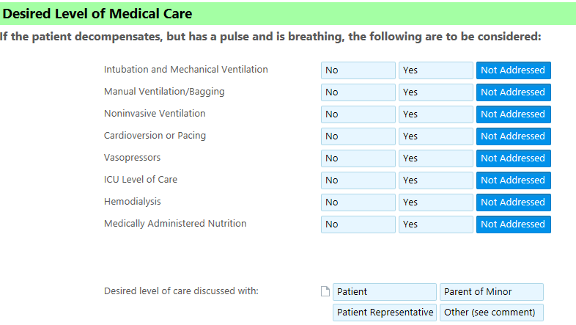
Converting POLST to Facility Orders
Code Status Full Code or DNR
Desired Level of Medical Care (DLMC)
aka Limitation of Treatment Orders (LOTO)
aka Scope of Treatment Orders (SOTO)
Comfort Care Orders, when indicated
Notes:
If not already in place in the hospital EMR it is helpful to design hospital orders that mirror the polst framework- very important to designate DNR as only referring to no CPR in setting of cardiopulmonary arrest and have a different way to order other limitations of treatment in prearrest situations- the most common treatment preference, best practice, to affirm on admission is code status for CPR/DNR and intubation/DNI. At providence we call the treatment orders in prearrest emergencies “Desired Level of Medical Care, aka DLMC) but other hospitals call this LOTO, SOTO… this list is not meant to be a checklist asked every patient, just would ask DNI routinely and then these other preferences are discussed in context of illness and goals only when appropriate or when outlined on POLST.

Slide 23
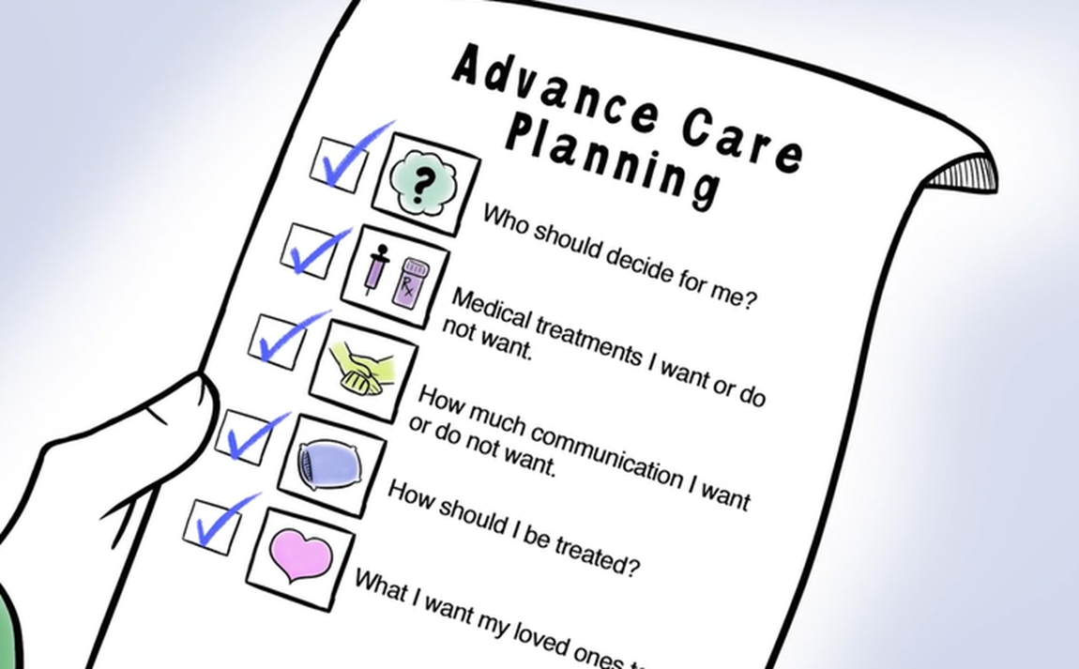
PATIENT EDUCATIONAL RESOURCES: AKPOLST.ORG
Introduction to the POLST for Patients and Families
Coming:
Patient guide for POLST preparation
Patient guide to the completed POLST
Advance Care Planning Videos: ACP, POLST, CPR, Levels of Care
Notes:
And to review offerings for patient/family education on the website: akpolst.org

Slide 24
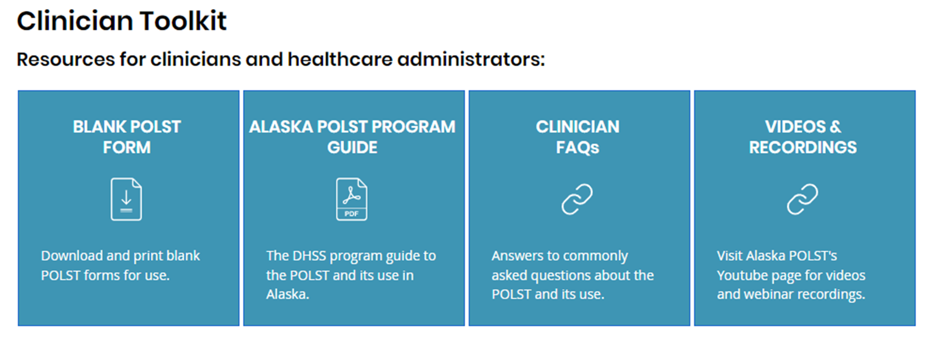
PROFESSIONAL EDUCATIONAL RESOURCES: AKPOLST.ORG
Introduction to the POLST, FAQs, Webinars
Coming:
POLST best practices
Policy share
Presentation slide share
Notes:
And the website’s professional offerings

Slide 25
POLICIES & PROCEDURES: SUCCESSFUL POLST USE IN HOSPITALS/ED
Develop Hospital and ED policies formalizing emergency protocols for POLST orders and how to convert to in-facility orders.
Consider updating format of in-facility orders to follow POLST framework.
Offer POLST after a goals of care conversation or use as a tool to frame the conversation.
Forms are no longer kept on file at local EMS/Dispatch:
Reinforce patient education on holding and presenting form.
Fax forms to local hospital to be on file.
Assure Medical Records Dept. knows about POLST
Notes:
Will have policy share on website
Emphasize process without dispatch-
Goal is to have an electronic registry- but realistically looking at >1 year to have in place
Have to work with paper forms-
Most emphasis/ed to patients/families/facilities/ALF to have forms and present to EMS
Have on record at local hospital which EMS can call to have read as medical orders from hospital on line control to EMS in field and follow those verbal orders on POLST
Or discuss on the local level with your community and EMS and dispatch how best to have back up systems in case patient’s can’t find forms or forget

Slide 26
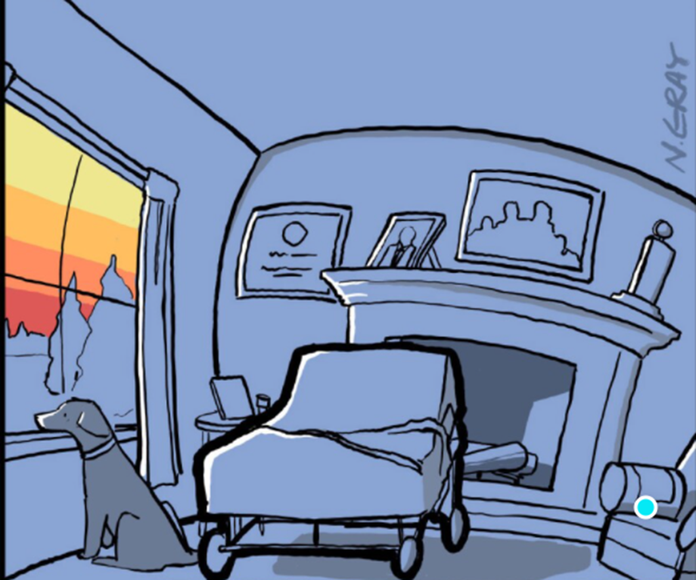
The acute care setting is where many patients with serious illness formulate goals to not return to the acute care setting
Nathan Gray, M.D. inkvessel.com
Notes:
There’s no place like home

Slide 27
akpolst.org

