Slide 1

Alaska POLST:
The Art of Communication
LTC Perspective
Sharmon Figenshaw ARNP
Washington POLST Task Force Co-Chair
Consultant to Alaska POLST LTC Work Group
“With a talented team of actors”
Notes:
Thanks to Ursula, and the the whole workgroup team who helped shape this presernation.

Slide 2

Created in Collaboration with the DHSS POLST Education Workgroup, LTC Subgroup:
Karen Mailer, MD, CMD
Medical Director
Providence Transitional Care Center (PTCC) Providence Extended Care (PECC)
Barbara Bigelow, MS, LNHA, CDP, RHIA
Nursing Home Administrator (Licensed AK & AZ)
Bigelow Community Consulting, LLC
Jeannie Monk, RN, MPH
Senior Vice President
ASHNHA
Ursula McVeigh, MD
Executive Medical Director
Hospice and Palliative Care
Providence Medical Group Alaska (PMGA)
Marianne Johnstone-Petty, DNP
Assoc. Medical Director
Palliative Care
Providence Medical Group Alaska (PMGA)
Hilary Walker, OTL
Advance Care Planning Coordinator
PeaceHealth NW Network
This and other LTC POLST programming made possible by:
Civil Money Penalty (CMP) Fund Grant Program from the Alaska Department of Health & Social Services
Special thanks to:
Providence Alaska Foundation for their partnership with ASHNHA to secure funds on behalf of this program.

Slide 3
1. How POLST is part of a voluntary process of advance care planning
2. Learn how conversation skills are used to:
--elicit personal goals and
-- determining need for POLST;
We will Introduce scripting that can help in having these conversations.
Understand the relationship of orders in Sections A and B of the POLST; and how the best conversations start with section B!
Review best practices and resources facilities, to ensure that POLST is accessible, understood and honored
GOALS
Notes:
In the last webinar, we covered :
1. How POLST is part of a voluntary process of advance care planning
2.The difference between POLST and advance directives
3. How the POLST form works:
The orders it contains
How it is put in effect
How it is honored
4. Who are candidates for POLST; who will honor POLST
5. Recommendations for transitioning from Comfort One to POLST
6. How MOST orders can also transition to support use of POLST
To review that material go to ASHNHA to view the recordings.
Today we will focus on the interactions that lead to effective use of POLST; and see how these important conversations can lead to each person getting care that is consistent with their goals and values;.
We will Introduce scripting that can help in having these conversations.

Slide 4
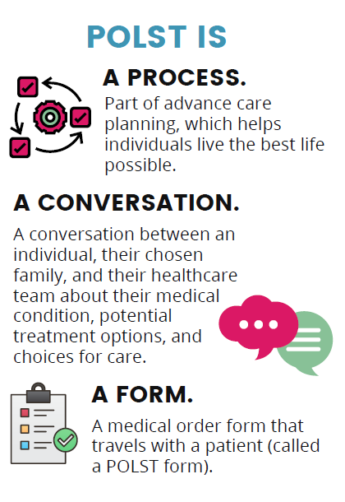
POLST BASICS
Notes:
We are here talking about the new Alaska POLST : as we do so we’lll be coming back to these pbasicc ideas central to what POLST is and ddrawingg on the collective wisdom of other states who have moved toward inccorproation of POLST, from Oregon’s revelatory inception over almost 30 years ago. To now.
As we use the lens of how POLSST works in SNF and LTC, we want to share this basic notion…
POLST is…a process,
A conversation,
And
A form.
First lets look at the process:

Slide 5
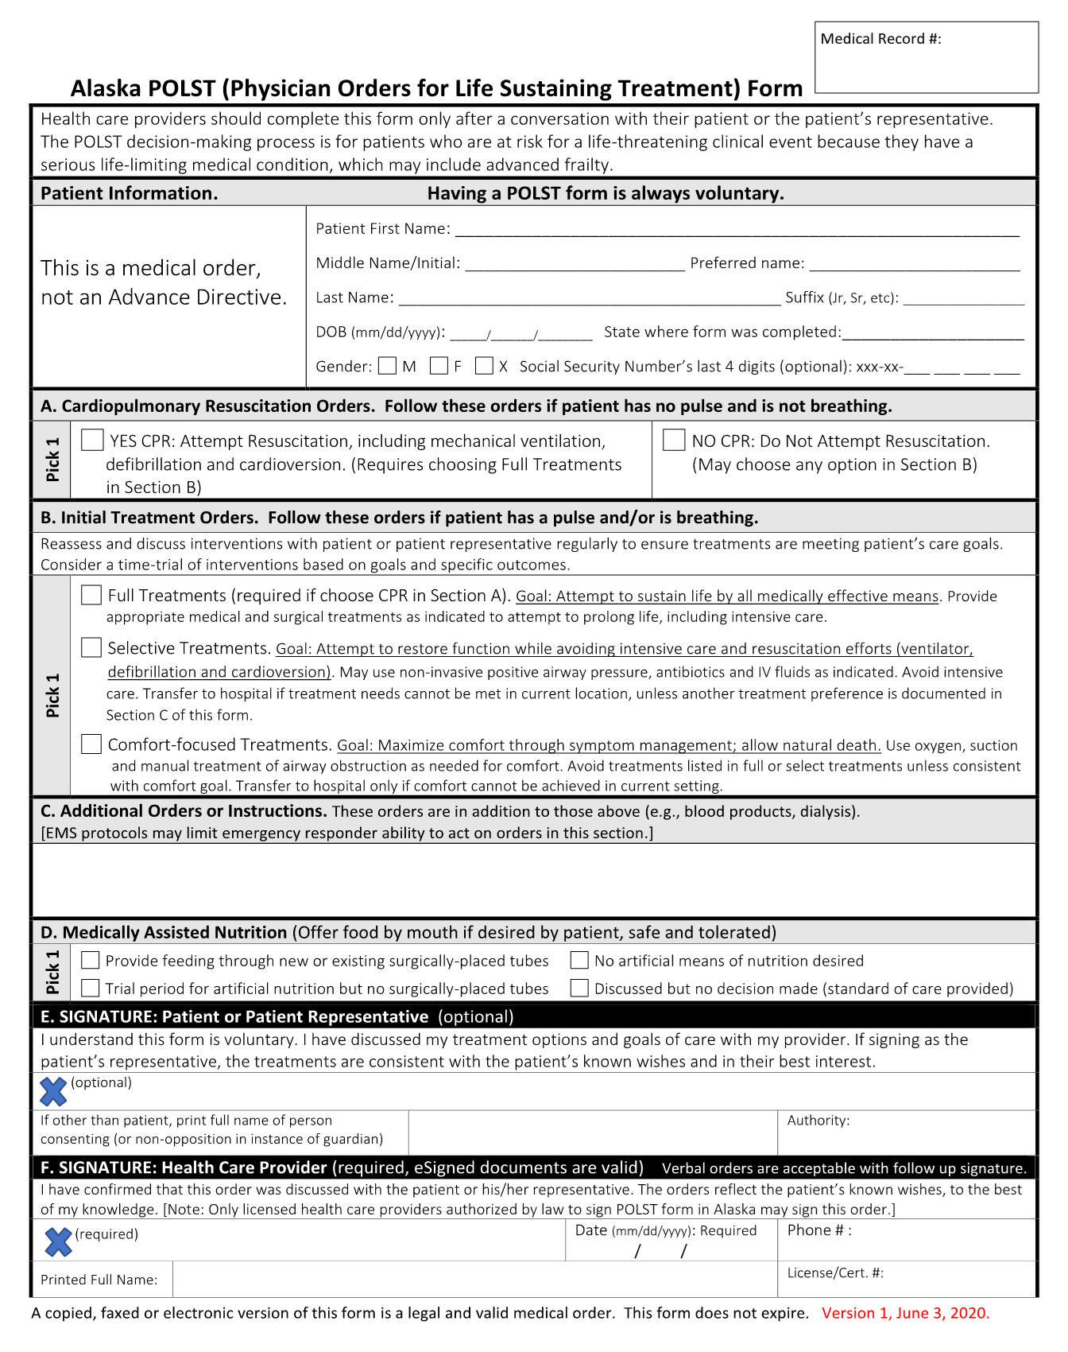
THE FORM
Portable Medical Orders
Actionable and Portable
Guides emergency care across settings
Gives EMS direct orders (unlike AD or MOST)
Must be signed by MD/DO,
  verbal orders may be taken by ARNP/PA, RN
Individual/legal representative may sign (recommended)
Consent and discussion are verified as part of order
Will be honored in most states; Alaska has chosen the National POLST form to comply closely with national standards
Notes:
This is a beautiful form, an efficient and effective way to honor people’s wishes.
When completed in the context of medical encounter with high quality conversation, it can lead to successful goal concordant ccare “in the mmoments”.
Vs AD which are meant to be a bit more cumbersome, used in less emergent situation. This really is designed to give the “right care right now” to the person according to their values

Slide 6
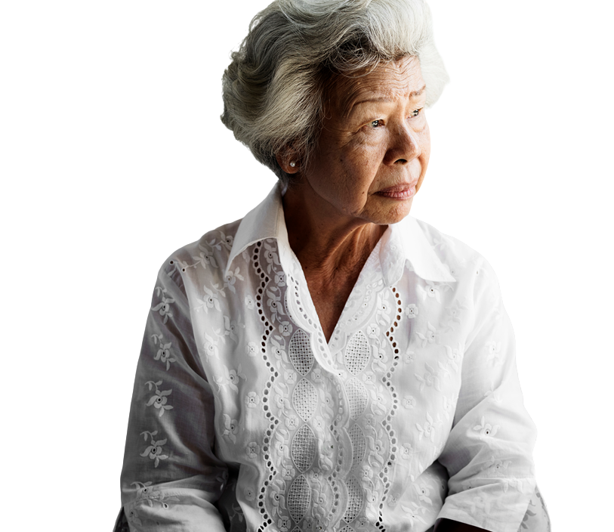
Who Should be
Considered for a POLST?
  Life expectancy –
    Would you be surprised if this individual died in the next 1-2 years?
  Would this person be potentially harmed by, or their overall condition worsened by, aggressive, invasive measures
  Increased risk of harm
  Medical conditional
  Personal values; preferences
Notes:
Ask the surprise question.
Mostly consider clinical…but you know this avout yyour residents..
Shared-Decision
High risk of unacceptable outcomes
Little chance if return to acceptable outcome./ QOL, level of function

Slide 7

THE CONVERSATION
Notes:
The “art” of POLST including the conversation, tips and tricks for talking with patients about the form, making sure that the orders makes sense.
The skills here will be useful to all clinicians,
While we will be looking at this today with the lens of SNF use, we welcome everyone in all clinical settings to practice using the guidance
Also: some policy and procedures you can apply will be covered.

Slide 8
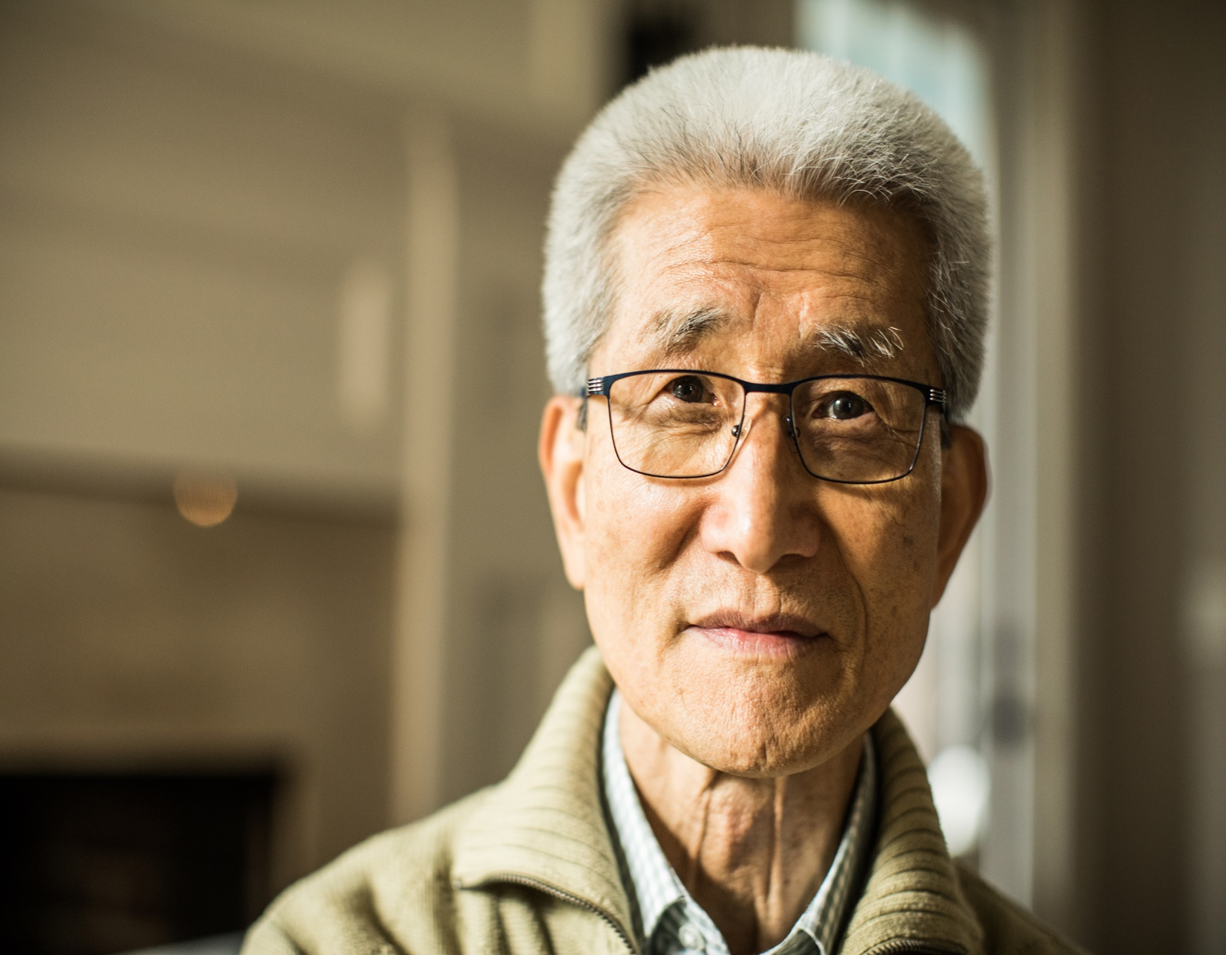
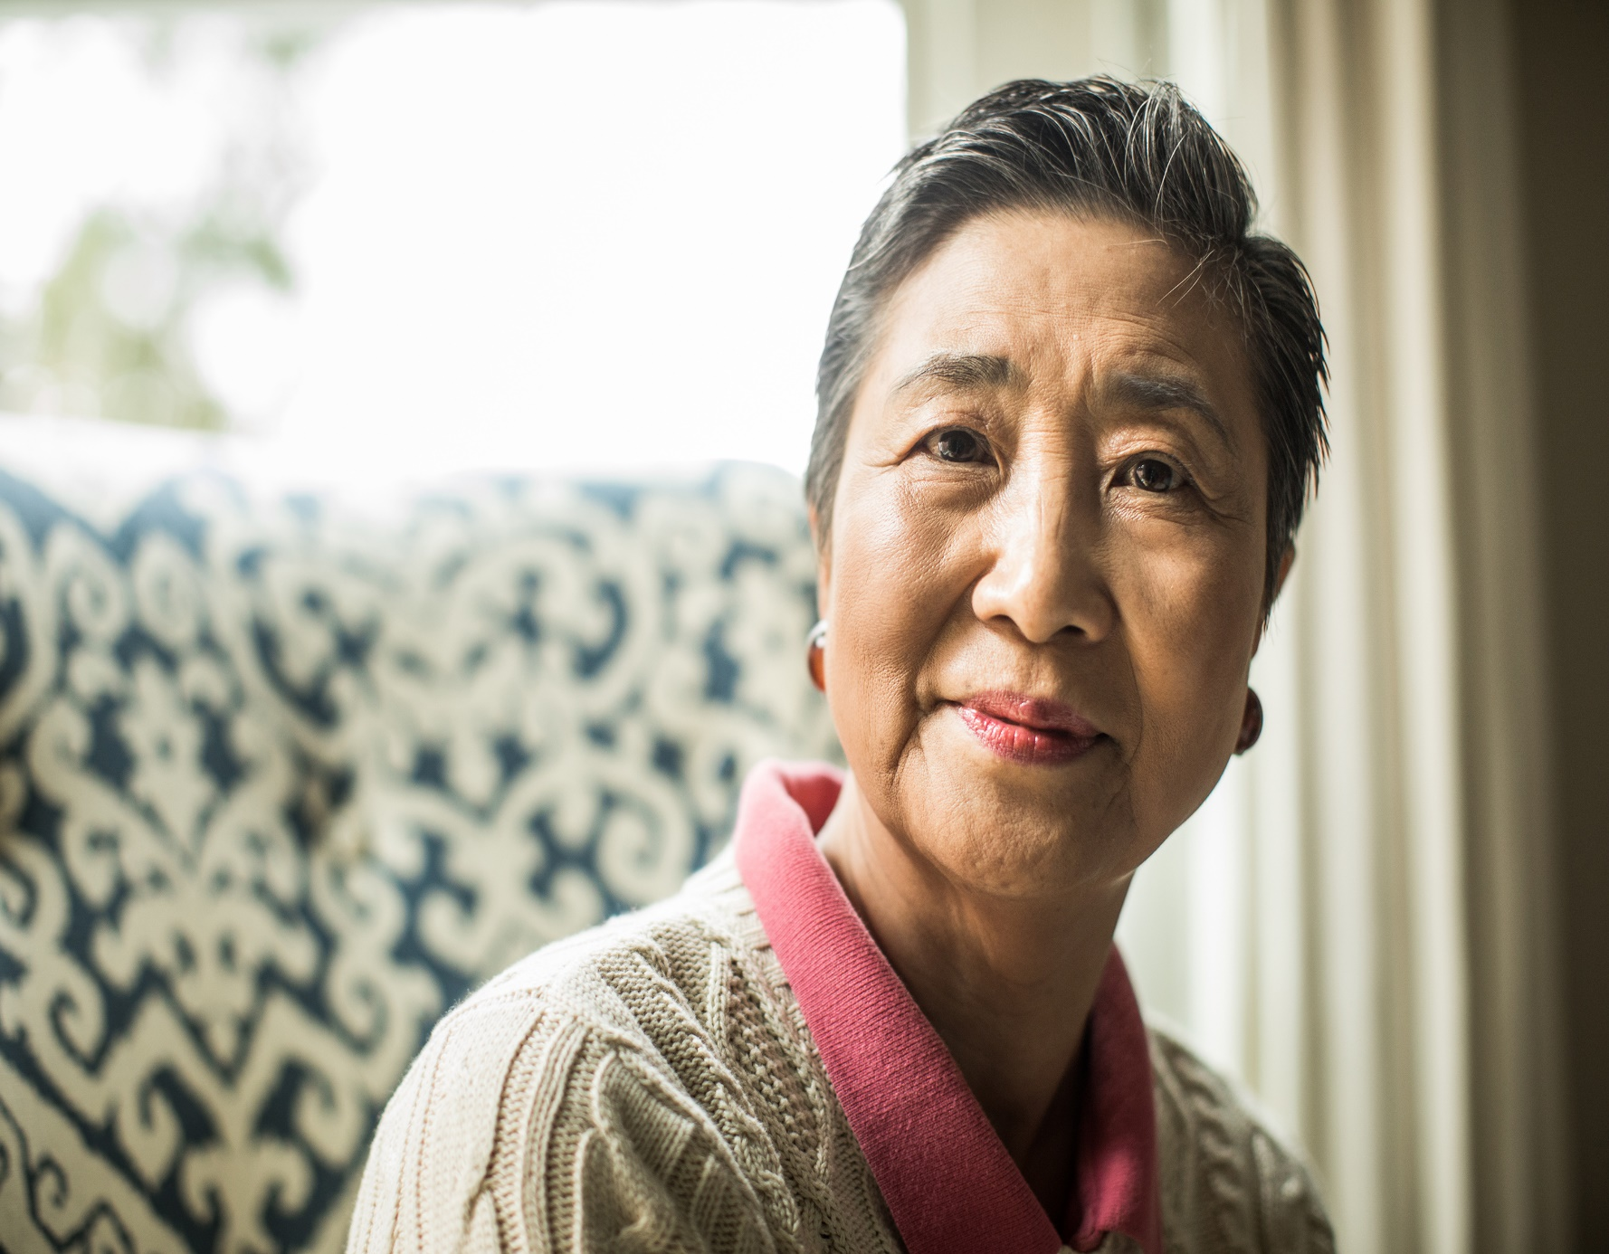
Meet Nikki and Joe
Notes:
Joe and Nik have been married for 56 years, They met during her first year at a local community college where Joe taught. They both studied Education, Joe continue to work at the community college where he eventually became Dean..and Nikki taught elementary school until they started having children. She stayed home for a few years. They had 3 kids. She taught in each school the kids attended growing up. Carrie is a financial planner and Dan is a HS teacher.. Their youngest daughter, Joan returned to their small college town after medical/ naturopathic training; she lives a few blocks from their old house.
Ever since they met, Joe and Nikki have always enjoyed doing things together. The family had a cabin at a nearby lake where they spent all their free time. Joe and the two oldest kids loved fishing. Nikki and their youngest daughter enjoyed hiking and medicinal plant collecting. They would often make teas, oils and tinctures together. Joe was a gourmet cook and loved to try out recipes on his family.
Their oldest, Kari, is a financial planning manager, their son, Dan,is a high school teacher and their youngest Joan is a naturopathic doctor.
Joe and Nikki retired almost the same time, they decided to sell their home and remodel the lake cabin to make it a full –time home. For several years they enjoyed the They were able to enjoy some long-desired travel adventures.
It was on an extended trip n Europe that Nikki began to worry about Joe’s memory. After a few more trips, they decided to have him evaluated; he was diagnosed with Alzheimers dementia. That was 8 years ago, he is now no longer able to do ADLs independently. Nikki provides increased care needs in the last 3 years. Nikki’s lifelong asthma has become CCOPD –hse had been hosp oncec 1-1/2 years ago with pneumonia for which Bipap was nneeded

Slide 9
Goals of Care Conversations for People with Serious Illness
Ask Permission
Introduce Agenda
Assess Understanding
Explore Key Topics
Align Intention
Respond to Emotion
Summarize and Determine Next Steps
Notes:
So next: High-quality goals of care conversations with…what do those conversation look like?
There are a number of models to choose from for these conversations, and I will be sharing some specifics of one model we have chosen to present in the newly launched Serious Illness Conversation Guide Trainings. We encourage you to join us for a training soon…
But lets take a high\ level view of what makes these conversations work. Each use a framework of intentional questioning, respectful sharing of information, and importantly, skillful listening for what is important and meaningful to the individual.
The result is that these conversations build trust between the individual and the health care provider by empowering the individual to have an active role in their own care planning.
Health Care Team Approach: Not JUST for providers
Many members of the clinical team can support goals of care conversations. Typically, prognostication is reserved for health care providers (MD, DO, ARNP, PA-C). Clinical chaplains, case managers, nurses, social workers, and therapy professionals (PT, OT, ST), are important members of the multidisciplinary team that can support and initiate many elements of the goals of care conversation within their scope of practice.
Characteristics of a high-quality goals of care conversation include:
Framing and Naming the Agenda
Asking permission.
Assessing the individual’s understanding of their condition matched with sharing prognosis in a way that aligns with the person’s intention (I hope/I wish/I worry)
Exploring key topics;
Responding to emotion, at least to humanly acknowledge it… when sharing information and mapping values
Summarize and determine next steps.
AS we look at these elements, I want to point out that the quality and intention of these conversations are “felt” right from the beginning…this is not your typical ” how’s it going” (thought it can start like that). The very first step in this diagram I like to call “Naming and framing”. This step, where you call out that this is a conversation with a specific intention/agenda, you are engaging that part of the person that knows how to give extra attention to what is important. The feeling of ‘this is going to be uncomfortable’ is met with a new level of attention “

Slide 10

Set Up the Conversation: Naming and Framing
Introduce the purpose/ Ask Permission:
“ I’d like to talk about what’s ahead with your illness…”
“Is this ok?”
Normalize:
“ I do this with everyone… so we can make sure to provide you with the care that matches your goals.”
Notes:
AS we look at these elements, I want to point out that the quality and intention of these conversations are “felt” right from the beginning…this is not your typical ” how’s it going” (thought it can start like that). The very first step in this diagram I like to call “Naming and framing”. This step, where you call out that this is a conversation with a specific intention/agenda, you are engaging that part of the person that knows how to give extra attention to what is important. The feeling of ‘this is going to be uncomfortable’ is met with a new level of attention “

Slide 11
Assess Understanding…Share Prognosis
  “Tell me what you know about your condition.”
  “How much do you want to know?”
  I’d like to share what I know.
    Is that ok?”
Share Prognosis (if appropriate/indicated)
  I hope…
  I wish…
  I worry
Assess the Individual’s Understanding
Notes:
Notice that before you start to share what you know, it is important to see :
This is based in your prognosis, a skill reserved for clinicians, but any member of the care team with knowledge of the person’s condition, especially if you as the provider are communicating with the rest of the team, can use these phrases
Use ” I hope…[you get to …]”
“I wish… [we weren’t in this situation]”
“I worry….[“that you are at risk for…” or “your condition might worsen suddenly”]
People will get overwhelmed with statistics and markers etc…
Using the I hope/ I wish I worry allows:
#1) Alignment—you really do hope they get to experience what they want
#2) Compassion—the feeling that you are sorry to have to share this news goes a long way.

Slide 12
Explore Key Topics
Goals
  “What are your most important goals if your health worsens?”
Fears and worries
  ”What are your biggest fears/worries about the future with your health?”
Sources of strength
  “What gives you strength as you think about the future with your illness?”
Critical abilities
  “What abilities are so critical to you that you can’t imagine living without them?”
Tradeoffs
  ”If you become sicker, how much are you willing to go through for the possibility of gaining more time?”
Family
  ”How much does your family* know about your priorities and wishes?”
Notes:
I know this is a busy slide but this gives you a chance to see the range of “key topics”
Another one:
Have you had experience with someone who has been seriously ill or on hospice?
ADD NOTE ABOUT TRAINING!!!
© 2015-2017 Ariadne Labs: A Joint Center for Health Systems Innovation (www.ariadnelabs.org) between Brigham and Women’s Hospital and the Harvard T.H. Chan School of Public Health, in collaboration with Dana-Farber Cancer Institute. Licensed under the Creative Commons Attribution-NonCommercial-ShareAlike 4.0 International License, http://creativecommons.org/licenses/by-nc-sa/4.0/

Slide 13

Close the Conversation
Summarize:
“I heard you say that….is important to you…”
Make a Recommendation:
“I recommend…
…we bring your family in…”
…we create orders that outline…”
…we make a list of things to talk about…”
Check-in/Confirm:
“How does that I sound?”
Reassure:
“I/we will be here to see you through this.”
Notes:
Notice that before you start to share what you know, it is important to see :
what the person understands AND
ask how much they want to know/ want to hear from you.
Tell me what you know about your condition.
Then ask:
“How much do you want to know?”
(depending on what they say…)
”I’d Iike to share what I know. Is that ok?”
This is based in your prognosis, a skill reserved for clinicians, but any member of the care team with knowledge of the person’s condition, especially if you as the provider are communicating with the rest of the team, can use these phrases
Use ” I hope…[you get to …]”
“I wish… [we weren’t in this situation]”
“I worry….[“that you are at risk for…” or “your condition might worsen suddenly”]
People will get overwhelmed with statistics and markers etc…
Using the I hope/ I wish I worry allows:
#1) Alignment—you really do hope they get to experience what they want
#2) Compassion—the feeling that you are sorry to have to share this news goes a long way.

Slide 14

Aligning Intention…Responding to Emotion
Remember NURSE(S)
N…ame
U…nderstand
R…espect
S…upport
E…xplore
(S)…ilence
stairsartplacesmosaiccreativephotography
https://www.vitaltalk.org/guides/responding-to-emotion-respecting/
Notes:
IMPORTANT: pacing with where the patient is at, stopping to acknowledge emotion along the way.
These techniques can help the beginning clinician have a range of responses.
Whatever you do, be with the person, give them the moment they need to process a strong save of emotion when they hear something difficult. Then usually you will see when it is ok to proceed

Slide 15
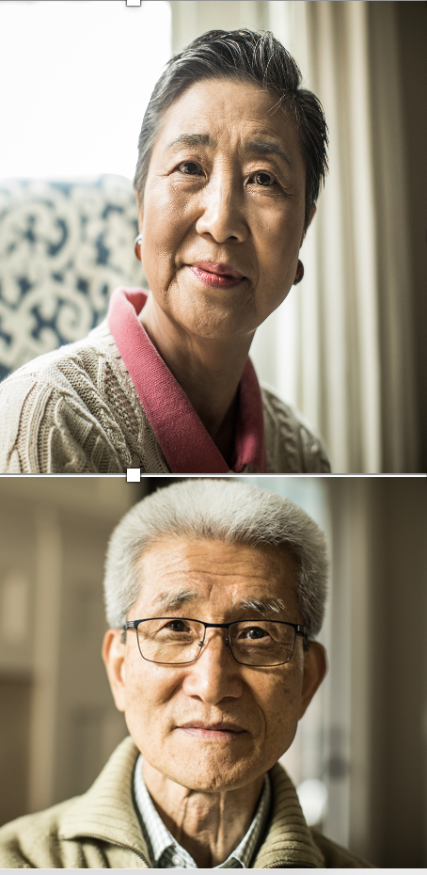
Nikki and Joe: The Medical Side
Nikki:
78 yr old w/ COPD/asthma, DM2.
Recent weight loss
Being discharged to rehab s/p admit for pneumonia
in hospital 8 days, required intubation for three days
Joe:
86 yo, mild hypertension, paroxysmal A-fib
Dx with Alzheimer’s dementia 8 years ago significant progression of memory and functional losses in the last 3 years.
He is continent and verbal; needs significant amount of help from Nikki.
Notes:
Nikki is 78 and has CCOPD with DM2. She is full time caregiver for Joe, 86 who is increasingly forgetful.
She has had a hard time getting to her medical appointment and keeping up with her self care,
She was hospitalized last year (14 months ago) for pneumonia during which she needed BiPAP for 2 days. She recovered well with rehab, but over the winter she again began to forget meals, lose weight in the midst of the caregiving needs for joe She became quite il and was again hospitalized and this time required intubation while the antibiotics took affect.
He is continent and verbal but is unable to perform ADLs without significant amount of help from Nikki.
Their daughter Joan, has been checking in daily and is increasingly worried about what caring for Joe is doing to Nikki, even before this hospitalization the family agrees a move to assisted living is warranted. Joan does the shopping and manages both their medications, though Nikki can easily take her own meds. They have let Carrie help with their finances for years and she has managed such that they can now afford long-term care for up to 10 years. Carrie Her family tries to spend the weekends at the lake with them

Slide 16

Joe and Joan with Hilary: Admission to Assisted Living
Notes:
Joe ( sharmon) and Joan (Jeannie) meet with the admission team (Hilary for the assisted)admission:
During the admission process, Rachel (Ursula) is reviewing the medical records and story that Joe comes in with. They have agreed that he can move in to be near Nikki during her rehab as long at family is able to stay with him to help him get oriented and provide for his care.
Joe does not have an advance directive or a POLST.
(Joining after they have made introductions and gotten oriented to what is needed for the admission).
Rachel has asked to hear a bit about Joe’s life/history..
Rachel: (Ursula): Thank you for sharing all that Joe. It sounds like you and Nikki have had some great adventures and share a great love.
How are you feeling about being here?
Joe: we’ve all talked about this a lot, Joanie things its best for Nikki, Whatever is best for Nikki. How is she? Can I see her?
Joan: We’ll go see her right after this Dad.
(turning to Rachel) Yes we are happy you could have a place for them and letting dad be here while mom is recovering in rehab.
Rachel: “Absolutely…and we want this to be the place where you live your life, Joe, with Nikki, the way you want. We want to make sure we know what is important to you so we can support that? If it ok if I ask some questions that will help us with that?
Joe: Sure, I hope I can answer,
Rachel: Its Ok Joe, and Joan feel free to help Joe if he needs it.
So Joe, I wonder what feels important to you as you move here?
Joe: Being with Nikki. That’s all I just need Nikki.
Joan, that’s right dad. As soon as mom is done with therapy, she’ll come and live with you in the apartment over here. Doesn’t that sound nice? We just have to be patient. Mom’s been through a lot.
Joe: I know, It was really scary seeing her so sick. I didn’t like seeing what they did to her.
Rachel (Ursula): That must have been hard,. I appreciate you sharing that, Joe; that’s important for us to know.
I wonder,,, what fears, or worries do you have as you think about your future being here with Nikki
Joe: I worry about Nikki, Nikki is my rock, I am more like a stone. I worry that taking care of me is too much for her.
Joan, He says that a lot. Dad, You’re no stone, Dad, but you are a bit of an old goat. (
Rachel: I can see your concern for Nikki, Jow.
She is very devoted to you, and you to her. You are both very lucky to have each other and we want to make it easier on both off you. How does that sound?
Joe: nice. I don’t want Nikki to get sick again—that was awful.
Rachel: I wonder…as u watched what your wife went through, does it affect what you would want for yourself? What do you think you’d be willing to go thru for a chance of gaining more time, like Nikki?
Joe: I don’t know. They were all over her, with tubes and things, She could hardly breathe and then she couldn’t talk. I’m just glad it worked. she went through all that, and did ok. When can I see her?
Rachel: In just a few minutes Joe, I want you to be able to see how close she will be to you. (ALIGN) Would it be Ok if I ask a few more questions?
Joe, I guess
Joe, if you think about a situation where you might get worse, like Nikki did, Do you think you’d want to go through all that to “get through it?”
Joe: “Um, I don’t know. I don’t think so. I’m not like Nikki. She is you know, herself. I am not so much anymore. Joanie, what do you think?
Joan: That’s right Dad. You’ve said how you just want to be with mom, and not to hook you up to machines. That it can’t help what’s happening in your brain.
Joe that’s right .. No machines, no pounding on my heart It cant help me. Nikki is my rock but I am becoming more like a stone (winks)
Rachel : Youu both have a big promise to take care of each other It’s clear your have talked about this and that Joan, you know what your dad would want.
Rachel: This is really helpful to know. I think that it might be useful to get our nurse practitioner to come see you about this. She can help you fill out some orders, called a POLST, that will help us all be able to honor your dad’s wishes
(4 minutes)
Take-Aways: What did you hear?
Sometimes its that easy—just listening

Slide 17
What Did you Hear?
--Setting the agenda?
--Asking permission?
--Assessing Understanding?
--Exploring key topics?
--Aligning with Intention?
--Responding to Emotion?
--Summary/Recommendations?
Notes:
Joe ( sharmon) and Joan (Hilary) meet with the admission team for the long term care admission:
During the admission process, Janine (Ursula) is reviewing the medical records and story that Joe comes in with. They have agreed that he can move in to be near Nikki during her rehab as long at family is able to stay with him to help him get oriented and provide for his care.
Joe does not have an advance directive or a POLST.
(Joining after they have made introductions and gotten oriented to what is needed for the admission).
Rachel has asked to hear a bit about Joe’s life/history..
Rachel: (Ursula): Thank you for sharing all that Joe. It sounds like you and Nikki have had some great adventures and share a great love.
How are you feeling about being here?
Joe: we’ve all talked about this a lot, Joanie things its best for Nikki, Whatever is best for Nikki. How is she? Can I see her?
Joan: We’ll go see her right after this Dad.
(turning to Rachel) Yes we are happy you could have a place for them and letting dad be here while mom is recovering in rehab.
Rachel: “Absolutely…and we want this to be the place where you live your life, Joe, with Nikki, the way you want. We want to make sure we know what is important to you so we can support that? If it ok if I ask some questions that will help us with that?
Joe: Sure, I hope I can answer,
Rachel: Its Ok Joe, and Joan feel free to help Joe if he needs it.
So Joe, I wonder what feels important to you as you move here?
Joe: Being with Nikki. That’s all I just need Nikki.
Joan, that’s right dad. As soon as mom is done with therapy, she’ll come and live with you in the apartment over here. Doesn’t that sound nice? We just have to be patient. Mom’s been through a lot.
Joe: I know, It was really scary seeing her so sick. I didn’t like seeing what they did to her.
Rachel (Ursula): That must have been hard,. I appreciate you sharing that, Joe; that’s important for us to know.
I wonder,,, as u watched what your wife went through, does it affect what you would want for yourself? What do you think you’d be willing to go thru for a chance of gaining more time, like Nikki?
Joe: I don’t know. They were all over her, with tubes and things, She could hardly breathe and then she couldn’t talk. I’m just glad it worked. she went through all that, and did ok. When can I see her?
Rachel: In just a few minutes Joe, I want you to be able to see how close she will be to you. (ALIGN) Would it be Ok if I ask a few more questions?
Joe, I guess
Joe, if you think about a situation where you might get worse, like Nikki did, Do you think you’d want to go through all that to “get through it?”
Joe: “Um, I don’t know. I don’t think so. I’m not like Nikki. She is you know, herself. I am not so much anymore. Joanie, what do you think?
Joan: That’s right Dad. You’ve said how you just want to be with mom, and not to hook you up to machines. That it can’t help what’s happening in your brain.
Joe that’s right .. No machines, no pounding on my heart It cant help me. Nikki is my rock but I am becoming more like a stone (winks)
Rachel: Joe, when you say becoming a stone, is that somethings that worries you? Could you tell me more about your fears and worries about the future?
Joe: Yes, I worry I am dragging Nikki down. She is getting sick taking care of me. I can’t help her. (Looks down and closes his eyes)
Joan: You’re no stone, Dad, but you are a bit of an old goat.
Rachel : Youu both have a big promise to take care of each other It’s clear your have talked about this and that Joan, you know what your dad would want.
Janine: This is really helpful to know. I think that it might be useful to get our nurse practitioner to come see you about this. She can help you fill out some orders, called a POLST, that will help us all be able to honor your dad’s wishes
(4 minutes)
Take-Aways: What did you hear?
Sometimes its that easy—just listening

Slide 18

Nikki and Joan meet with Marianne DNP
Notes:
Marianne: Hello Nikki! Do you remember me from the first time you were here last year.
Nikki, of course I do. You always had a cute story about your dog. How is he?
M: Still digging up the backyard, Im afraid. You just had another tough go in the hospital…how are you feellilng now?
Nikki: OK I guess, I can tell the infection is better—I can breathe again, though I have a ways to go to get my energy back.
M: I wonder if we could take a few minutes to review the information I have from the hospital
Nikki: I was a little foggy when they were going through it all.
M: well then its good we take a minute to make sure we’ve got it right.
As you know we want to make sure we care for you in the way you prefer. Its ggood to know, if you got sicker, what kinds of things you would do /not do.
Nikki: Is that what that green form is about? I had one from last year but I think they made a new one
Marianne
Marianne: Hello Nikki! Do you remember me from the first time you were here last year.
Nikki, of course I do. You always had a cute story about your dog. How is he?
M: Still digging up the backyard, Im afraid. You just had another tough go in the hospital…how are you feellilng now?
Nikki: OK I guess, I can tell the infection is better—I can breathe again, though I have a ways to go to get my energy back.
M: I wonder if we could take a few minutes to review the information I have from the hospital
Nikki: I was a little foggy when they were going through it all.
M: well then its good we take a minute to make sure we’ve got it right.
As you know we want to make sure we care for you in the way you prefer. Its ggood to know, if you got sicker, what kinds of things you would do /not do.
Nikki: Is that what that green form is about? I had one from last year but I think they made a new one
Marianne

Slide 19
What did you hear?
--Setting the agenda?
--Asking permission?
--Assessing Understanding?
--Exploring key topics?
--Aligning with Intention?
--Responding to Emotion?
--Summary/Recommendations?
Notes:
Marianne: Hello Nikki! Do you remember me from the first time you were here last year.
Nikki, of course I do. You always had a cute story about your dog. How is he?
M: Still digging up the backyard, Im afraid. You just had another tough go in the hospital…how are you feellilng now?
Nikki: OK I guess, I can tell the infection is better—I can breathe again, though I have a ways to go to get my energy back.
M: I wonder if we could take a few minutes to review the information I have from the hospital
Nikki: I was a little foggy when they were going through it all.
M: well then its good we take a minute to make sure we’ve got it right.
As you know we want to make sure we care for you in the way you prefer. Its good to know, if you got sicker, what kinds of things you would do /not do.
Nikki: Is that what that green form is about? I had one from last year but I think they made a new one
Marianne
Marianne: Hello Nikki! Do you remember me from the first time you were here last year.
Nikki, of course I do. You always had a cute story about your dog. How is he?
M: Still digging up the backyard, Im afraid. You just had another tough go in the hospital…how are you feellilng now?
Nikki: OK I guess, I can tell the infection is better—I can breathe again, though I have a ways to go to get my energy back.
M: I wonder if we could take a few minutes to review the information I have from the hospital
Nikki: I was a little foggy when they were going through it all.
M: well then its good we take a minute to make sure we’ve got it right.
As you know we want to make sure we care for you in the way you prefer. Its ggood to know, if you got sicker, what kinds of things you would do /not do.
Nikki: Is that what that green form is about? I had one from last year but I think they made a new one
Marianne

Slide 20
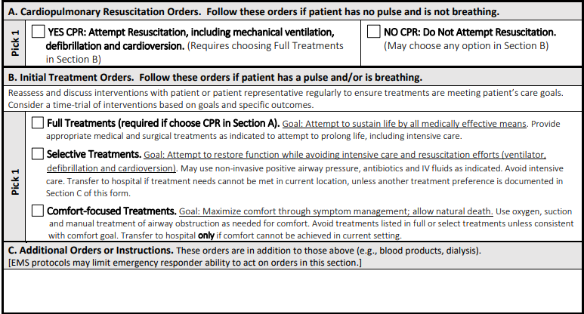
Start with Section B:
Identify goals for “sicker but alive” scenario first!
Notes:
Discussion of POLST Should Start with Section B
Starting with Section B builds rapport for exploring difficult decisions by first exploring scenarios in which the individual is alive. Section B translates the individual’s identified goals of care into a level of care preference. Completing Section B first will help inform guidance on the CPR decision in Section A.
Guide the individual in understanding the implications of their decision in Section B within the context of their medical condition and prognosis.
Normalize why you want to start here and how it can feel awkward.
Address Section B before A:
Full:
Selective: May include surgery with short-term intubation
Comfort: clear
After understanding a person’s goals,
After deciding that the person might benefit from a POLST form…
Then apply what you know about the person’s goals to specific likely scenarios.
(AS a person with a serious illness, you know that the risk exists for sudden changes in health…)
Again: I hope….I worry….

Slide 21
Location, location, location:
Treatment Preferences and Location of Care
Notes:
Explore a scenario in which the individual has a medical emergency. Provide level-of-care options by describing the location of care delivery.
Example
Scenario: Alex Person (above) develops a pulmonary embolism; suddenly has difficulty breathing and cannot speak for herself.
Discussion: Time-limits are an important concept given Alex Person’s stated goal, “Agree to prolong life with machines for family to arrive”. Discussion around time-limits allows the exploration of “Full Treatment” as well as preferences for time-trials. Explain what “Full Treatment” encompasses, including potentially having a breathing tube and being on a ventilator.
Decision: Suggest “Full Treatment in Section B. Alex Person may also indicate preferences in “Additional Orders” found in the line at the end of Section B. IN this situation, “Additional Orders” are “Full Treatment such as intubation ok up to 2 weeks, long only if improvement is clear, o/w transition to comfort”.
Original Text:
START HERE>>
Address Section B before A:
Full:
SelectiveMay include surgery with short-term intubation
First Response/ Option: Nothings off the table. Ok w/ ICU; yes to ventilator, dialysis/machine LST; need to discuss time-limits for advance directives
Second Response/ Option: Drawing the line at ICU. Ok w/ being in the hospital, but not the ICU, treat treatable conditions, antibiotics for reversible infections, discuss all reasonable treatments event surgery if goal is defined.
Third Response/Option: Home is best. No return to hospital; manage symptoms of underlying disease; allow natural death; consider hospice of palliative care referral.

Slide 22
Section A: Resuscitation Options
Yes to CPR
Look for Choice in Section B
Full Treatments
OR
Selective Treatments
Comfort Treatments
DNR/AND
Only
Notes:
Match resuscitation choices in Section A to range of treatment options in Section B.
The selection made in “Section B: Level of Medical Interventions” can inform the provider’s guidance to the individual in deciding their preference on whether or not to attempt CPR. Guide the individual in understanding the implications of having CPR in the context of their medical condition and address how the decisions made for “Section B: Level of Medical Interventions” affects resuscitation choices. Use their goal and the decision in Section B as a basis for making a recommendation about whether or not to attempt CPR.
Original Text:
Form follows function.
Designed to be a CARE DELIVERY Slide
First: In an emergency, should I perform CPR?

Slide 23
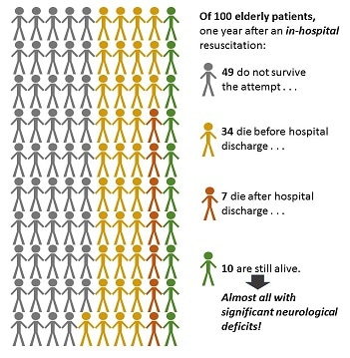

CPR Statistics
NOTE: In a review of patients who had CPR in LTC settings,
only 2% will survive to be discharged after the arrest.
Geripal.org, September 11, 2013
Notes:
When CPR is attempted how many adults survive beyond 30 days?
1.7% adults living in a nursing facility
5-10% adults with chronic illness
10-13% adults living independently
For People over 70 years of age: 81% think they have over a 50% chance of surviving CPR; 23% of those thought their chances were 90%
Crossing the Quality Chasm: Don Berwick:
Defines Quality Care as: Care that is SAFE, EFFECTIVE, Patient-Centered, Timely Efficient, Equitable
Requires a commitment to make sure ind/people are educated about their condition and understand the ramifications of the decisions they are being asked to make:
One study (which I for some reason didn’t add the reference to here and now cannot track down!!!) found that among people >70 yoa, 81% of them believe that they have a 50% (or better) chance of surviving and discharging home; 23% of those thought chances were 90%!!!
Most don’t equate CPR to life support—these are the same people that “don’t want to live like a vegetable”.
The question, as my mentor Dr. Stu Farber used to say, is what kind of vegetable do you not want to be?
Need help finding/creating the graphic.

Slide 24
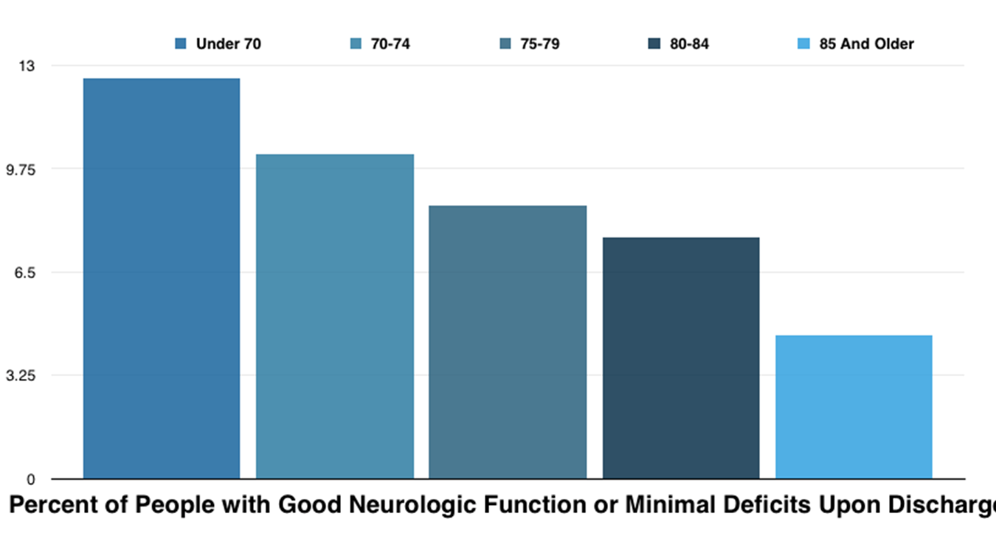
Significant Neurological Disability & CPR
https://jamanetwork.com/journals/jamainternalmedicine/fullarticle/1735894
Notes:
This one:
https://jamanetwork.com/journals/jamainternalmedicine/fullarticle/1735894
Development and Validation of the Good Outcome Following Attempted Resuscitation (GO-FAR) Score to Predict Neurologically Intact Survival After In-Hospital Cardiopulmonary Resuscitation
Mark H. Ebell, MD, MS^{1,2}; Woncheol Jang, PhD³; Ye Shen, PhD¹; et al
is the core study that all the of other references seem to come from.

Slide 25

Continue the Conversation/ Revise when Needed
Remember the 6D’s:
Decade
Divorce
Diagnosis
Decline (in health of you or agent)
Death
Distance
Notes:
Make it part of the habit in your family to review and discuss.
Think about it, talk about it, write it down, share it around.
The more who

Slide 26
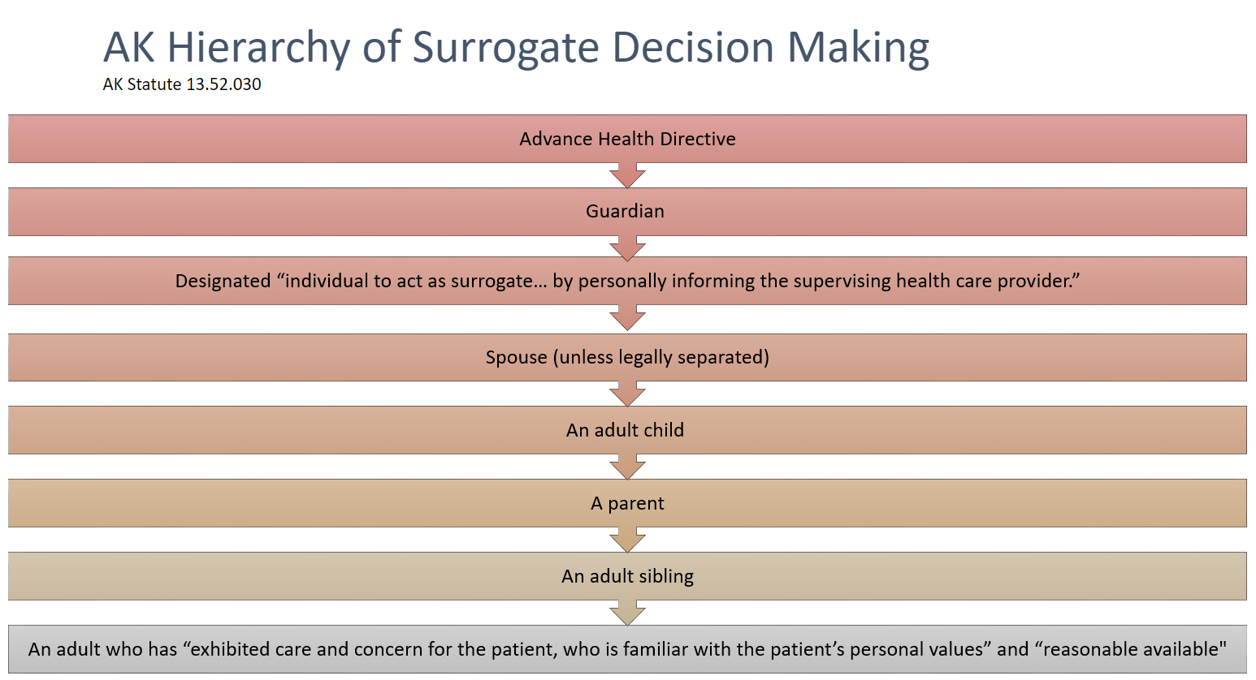

WHO CAN FILL OUT A POLST FORM IF
THE PATIENT LACKS CAPACITY?
WE CAN HELP WITH THESE
parent
Notes:
Durable Power of Attorney for HealthCare:
This document assigns health-care decision making authority to person’s chosen agent.
Can only be appointed by the individual.
Most legal/BEST way to choose agent
If no documents exist, individual can name a “trusted decision maker” (TDM) verbally to a health care provider.
If neither of these exist, follow the hierarchy in state statute re: who can act as surrogate
Important for people to understand what happens when surrogacy is assigned from the hierarchy without an active choice by the individual:
All members of one class must either:
Vote on who will make decisions
Make decisions by consensus (or majority rule if unable to come to consensus)
Guardians may offer a non-objection to the physician’s recommendation (assent or non-opposition) : formal ‘non-opposition letter”

Slide 27
Alaska law requires all healthcare professionals to follow POLST Orders
WHO CAN (MUST)
HONOR POLST?
All health care professionals
  (includes EMT’s, first responders, and health care providers and clinicians in all settings):
  Shall comply with POLST orders
  Must honor the completed POLST form
  Be provided immunity from civil or criminal liability
  Covers how to handle disputes
This includes all skilled and long-term care facilities!
Notes:
Patients or surrogates can modify or void a POLST form
If dispute arises regarding existing treatment orders on a POLST:
EMS: clarify understanding and contact On-Line Medical Control. If conflict continues to exist, transport to a hospital where there is more time to address conflict
Health Care Facilities and Organizations: follow your policy regarding surrogate/health care decision-making

Slide 28




Consider
ADVANCE CARE PLANNING/
POLST FOR HEALTH CARE FACILITIES
Process: Policies and Procedures
Training: Skills, documentation
Regular review and confirmation
Ensure clarity and access
Notes:
Refer to samples from other states on the website.
If anyone would like to join the LTC POLST work/sub-group!! Please let us know.
Create /review policies and procedures:
how your facility will incorporate ACP into care plans
Training expectations for staff
Policies for introducing, assisting with, and honoring POLST and AD
Consider having a policy for Trusted Decision Makers (TDM)*
Ensure staff is competent in assisting with advance care planning
Involve resident, healthcare agent/surrogate, other trusted advocates
Know when to recommend/offer POLST
Involve primary health care team
Remember MD/DO must sign POLSTDiscuss prior wishes, advance directives, POLST with
every admission/change in status
in quarterly /annual conferences.
Know when to offer POLST; communicate with health care provider when appropriate.
Check that orders, including POLST, are consistent with the person’s known values/ priorities, and with other ACP documents.
Keep POLST and other ACP documents together and easily accessible in an emergency.
Send original POLST (and other documents) with individual if transfer is necessary.

Slide 29
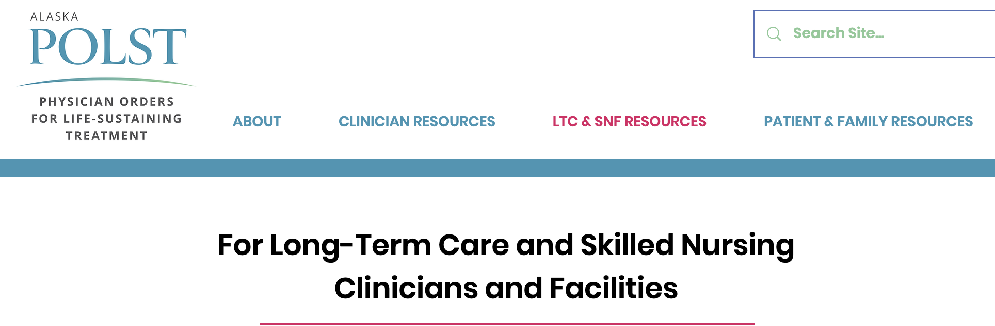
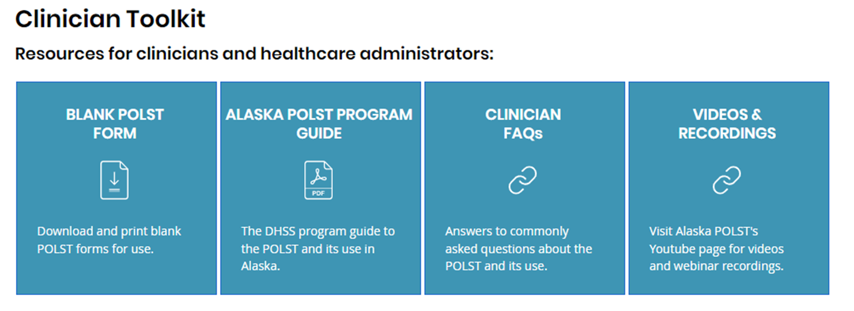
Alaska POLST Website: Resources for LTC/SNF
--Introduction to the POLST
--POLST FAQs
--Recordings of Webinars
Coming:
  --POLST best practices
  --Policy share
  --Presentation slide share
Notes:
Please note the current offerings on the website…
continue to check for more resources as this site will hold presentations, updates, templates and more.

Slide 30
akpolst.org
Notes:
Join us for the next webinar,
Consider joinging the team,
Submit questions to XXXX

