Slide 1
Alaska POLST Basics
LTC Perspective
Sharmon Figenshaw ARNP
Washington POLST Task Force Co-Chair
Consultant to Alaska POLST LTC Work Group
Ursula McVeigh MD
Executive Medical Director, Hospice and Palliative Care Providence Medical Group Alaska (PMGA)
Notes:
Thanks to Ursula, and the the whole workgroup team who helped shape this presernation.

Slide 2
Created in Collaboration with the DHSS POLST Education Workgroup, LTC Subgroup:
Karen Mailer, MD, CMD
Medical Director Providence Transitional Care Center (PTCC) Providence Extended Care (PECC)
Barbara Bigelow, MS, LNHA, CDP, RHIA
LTC Administrator South Peninsula Hospital (SPH)
Jeannie Monk, RN, MPH
Senior Vice President ASHNHA
Ursula McVeigh, MD
Executive Medical Director
Hospice and Palliative Care Providence Medical Group Alaska (PMGA)
Marianne Johnstone-Petty, DNP
Assoc. Medical Director Palliative Care Providence Medical Group Alaska (PMGA)
This and other LTC POLST programming made possible by: Civil Money Penalty (CMP) Fund Grant Program from the Alaska Department of Health & Social Services
Special thanks to:
Providence Alaska Foundation for their partnership with ASHNHA to secure funds on behalf of this program.

Slide 3
1. How POLST is part of a voluntary process of advance care planning
2.The difference between POLST and advance directives
3. How the POLST form works:
The orders it contains
How it is put in effect
How it is honored
4. Who are candidates for POLST; who will honor POLST
5. Recommendations for transitioning from Comfort One to POLST
6. How MOST orders can also transition to support use of POLST
GOALS FOR TODAY

Slide 4
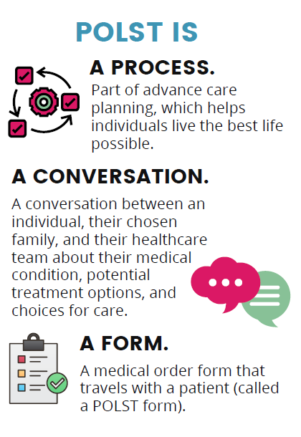
POLST BASICS
Notes:
We are here talking about the new Alaska POLST : as we do so we’lll be coming back to these pbasicc ideas central to what POLST is and ddrawingg on the collective wisdom of other states who have moved toward inccorproation of POLST, from Oregon’s revelatory inception over almost 30 years ago. To now.
As we use the lens of how POLSST works in SNF and LTC, we want to share this basic notion…
POLST is…a process,
A conversation,
And
A form.
First lets look at the process:

Slide 5
Advance Care Planning (ACP) is:
Advance care planning is for every adult
Thinking about what is important & who is trusted to make decisions
THE PROCESS
Conversations about what matters, and who is trusted to help with or make decisions
Writing down what others need to know
Making sure everyone understands and can find the plan; sharing it with the health care team; policies and training to ensure it will be honored
Notes:
I hope this is a familiar one to most of you…that the process is the process of ACPP,
That this consists of….
But lets take a moment to realize how particularly this pertains to LTC.
People coming to spend the “rest of their lives”, planning that this is the last “home” they will have,
Yet allll too often, the admission process avoids the opportuuity to be a partner in createing this new future.
titrate
We ask “do you have an AD and leave it at that.
So keep this process in mind with each admission..

Slide 6
Legal Documents:
Advance Directives
Durable Power of Attorney for Health Care
Health Care Directive / Directive to Physicians
Living Will
Medical Plans/Orders:
ACP informs the medical plan of care
New: POLST | Previous: Comfort One
POLST is for those with:
Serious illness
Chronic Progressive Illness
Frailty
ADVANCE CARE PLANNING (ACP)
DOCUMENTATION
Notes:
And keep in mind the responsibility we can assume byt helping make sure these plans really are documented .
This is justa brief recap, but will be revisiting parts of this later.
We will see how POLST expands the target population as noted here.
Whereas, Comfort One was ccrreated mostly for hospice patients when a ddeath at home was expected and preferred, now patients who are living with serious ill\nss

Slide 7
POLST & ADVANCE DIRECTIVES
 | POLST | Advance Directives
Who is it for? | Serious illness/frailty (including children) | All adults
When is it ‘in effect’? | Now: current condition/ current care | Future: unknown conditions or events
Completed by | Healthcare team + individual/surrogate discuss. Must be signed by MD/DO (others by verbal order). Individual may sign. Surrogate may consent/sign if individual has lost capacity | Individual with capacity completes and signs. May consult with others. Cannot be completed by a surrogate
Results in: | Medical orders that can: direct care of all professionals across settings: home/ community, SNF/LTC, to hospital admission | Legal document(s) that can: Name a healthcare decision maker State preferences for future care
Situations | Active orders from time of signature, pertains to current care or decline | Individual has lost capacity to speak for themselves. Decisions pertain to irreversible condition or terminal illness
Portability/ Actionability | May be stored/ accessed in health care system. Actionable by all professionals | Individual/family responsible for storage/retrieval. Interpretation by certain members of health care team
Review | Health care team responsible for review/updates | Individual responsible for updating (as long as they maintain capacity)
Notes:
Use this cocmparison chart to help others. Ppatients explain why POLST is useful/necessary

Slide 8
THE CONVERSATION
Next webinar:
The Art of the POLST in Skilled Nursing Facilities
Feb 8, 12:00PM
Notes:
The “art” of POLST including the conversation, tips and tricks for talking with patients about the form, making sure that the orders makes sense.
The skills here will be useful to all clcinicians, we will putting the lens of SNF use, but I would encourage others to come.
Also some policy and procedures you can apply will be covered.

Slide 9
Studies of POLST effectiveness show:
POLST orders match the treatment received 94-99% of the time^{1,2,3}
No documented misinterpretations of the form once EMS care was initiated³
Intervention in SNF to increase GOC conversations led to increased documentation of treatment preferences (69%) and POLST (87%).⁴
Having POLST for resident (SNF) to reflect goals of care reduced preventable hospitalizations by 40% and total hospitalizations by 25%⁵
WHY POLST?
Notes:
1. POLST followed for 99% of patients of Honoring Choices program in MN: http://www.dhs.state.mn.us/main/groups/healthcare/documents/pub/dhs16_197234.pdf.
2. Journal of American Geriatrics, Vol 64, Issue 8, pg1739-41. Physician Orders for Life-Sustaining Treatment Medical Intervention Orders and In-Hospital Death Rates: Comparable Patterns in Two State Registries
Alvin H. Moss MD,Dana M. Zive MPH,Evan C. Falkenstine BS,Erik K. Fromme MD, MCR,Susan W. Tolle MD
3. Concordance of Out-of-Hospital and Emergency Department Cardiac Arrest Resuscitation With Documented End-of-Life Choices in Oregon
Presented as an abstract at the Society for Academic Emergency Medicine western regional meeting, March 2013, Long Beach, CA.
Derek K. Richardson, MD, MPH∗,Correspondence information about the author MD, MPH Derek K. RichardsonEmail the author MD, MPH Derek K. Richardson
, Erik Fromme, MD, MCR
, Dana Zive, MPH
, Rongwei Fu, PHD
, Craig D. Newgard, MD, MPH
4. J Am Geriatr Soc. 2016 Nov;64(11):2385-23 doi: 10.1111/jgs.14463. Epub 2016 Sep 27.
An Interim Analysis of an Advance Care Planning Intervention in the Nursing Home Setting
Susan E Hickman ¹ ², Kathleen T Unroe ² ³ ⁴, Mary T Ersek ⁵, Bryce Buente ⁴, Arif Nazir ³ ⁴, Greg A Sachs ² ³ ⁴
DOI: 10.1111/jgs.14463
5. Health Aff (Millwood). 2017 Mar 1;36(3):441-450.
doi: 10.1377/hlthaff.2016.1310.
Initiative To Reduce Avoidable Hospitalizations Among Nursing Facility Residents Shows Promising Results
Melvin J Ingber ¹, Zhanlian Feng ², Galina Khatutsky ³, Joyce M Wang ⁴, Lawren E Bercaw ⁵, Nan Tracy Zheng ⁶, Alison Vadnais ⁷, Nicole M Coomer ⁸, Micah Segelman ⁹
Affiliations expand
PMID: 28264945
DOI: 10.1377/hlthaff.2016.1310
6. ⁵Oregon Health & Science University, Department of Emergency Medicine, Center for Policy and Research in Emergency Medicine, Portland, ORintervention reduced hospitalizations for diagnoses considered potentially avoidable by nearly 40% and total hospitalizations by 25%. This reduction was associated with Medicare savings of $236 per resident in 2014 and $408 per resident in 2015 (Ingber, Feng, Khatutsky, Wang, et al., 2017). intervention reduced hospitalizations for diagnoses considered potentially avoidable by nearly 40% and total hospitalizations by 25%. This reduction was associated with Medicare savings of $236 per resident in 2014 and $408 per resident in 2015 (Ingber, Feng, Khatutsky, Wang, et al., 2017).

Slide 10
COMFORT ONE TO POLST
2021 ALASKA POLST REGULATION
Renamed program from Comfort One Program to Alaska POLST Program.
Changed from Comfort One form to Alaska POLST Form.
Includes a comprehensive Reference Document to guide POLST form use.
Alaska POLST form and program modeled after National POLST- national consensus project to develop best practices for state POLST programs.

Slide 11
Introduction
Intended Population
Who can fill out a POLST form?
Who can(MUST) follow the POLST Orders?
ALASKA POLST REFERENCE DOCUMENT
Notes:
Link will be in the chat

Slide 12
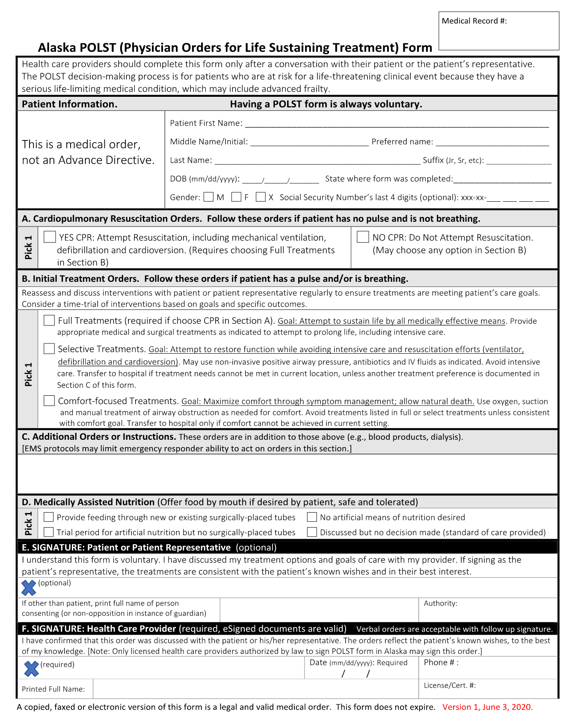
THE FORM
Portable Medical Orders
Actionable and Portable
Guides emergency care across settings
Gives EMS direct orders (unlike AD or MOST)
Must be signed by MD/DO,
verbal orders may be taken by ARNP/PA, RN
Individual/legal representative may sign (recommended)
Consent and discussion are verified as part of order
Alaska POLST has adopted the form created by National POLST
Will be honored in most states

Slide 13
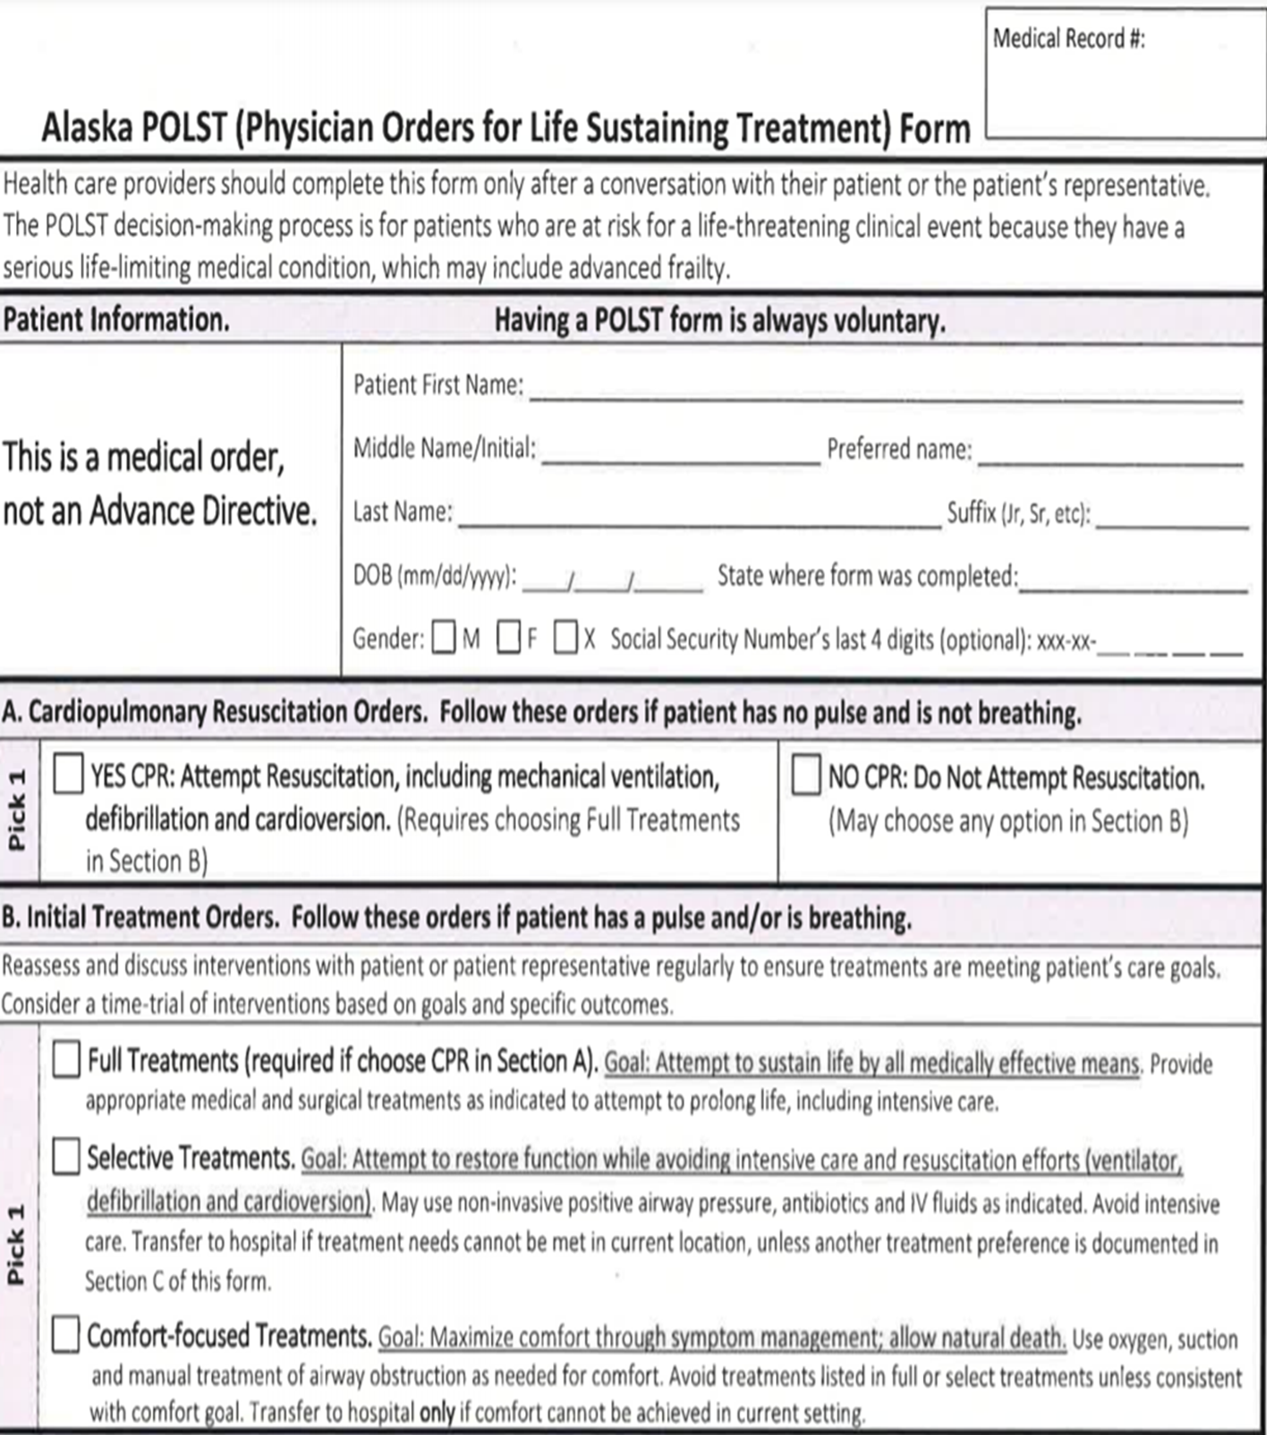
HIGHLIGHTS OF THE ALASKA POLST FORM
MEDICAL ORDER, not advance directive:
Transferrable, portable, and consistently interpreted
A.”CPR orders”
Preference for care when death is imminent
(Full Code vs DNR)
B. ”Initial Treatment orders”
Preference for level of care during distress /illness without arrest:
“Where do they want to be cared for?”
Home or LTC i.e. “in place”
Hospital but no ICU
ICU with full interventions

Slide 14
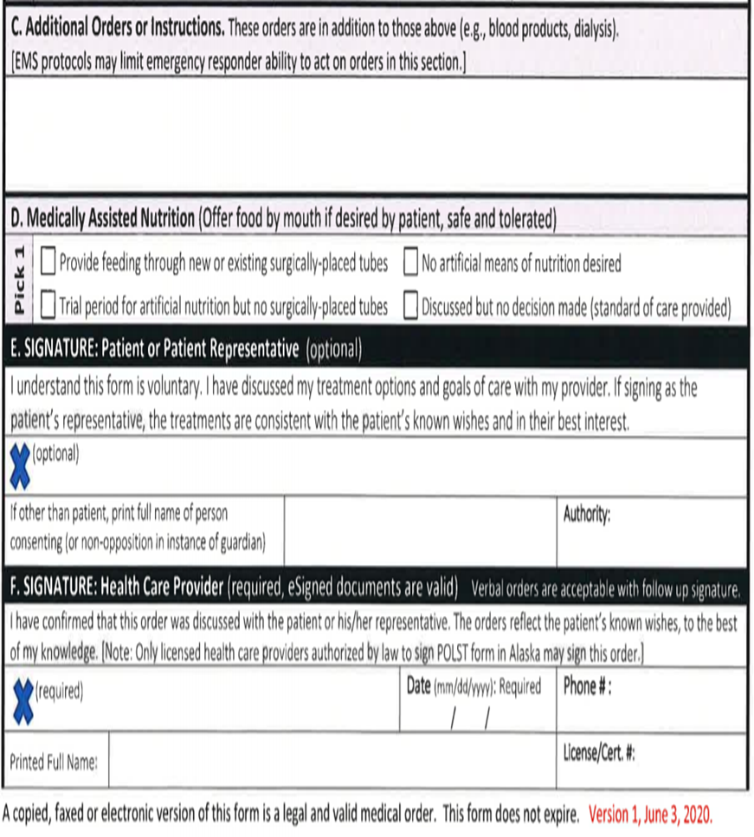
HIGHLIGHTS OF THE ALASKA POLST FORM
“Additional orders” section used to individualize orders:
IV antibiotics vs Oral antibiotics
Med-Evac yes/no
Contains preference for medically-assisted nutrition and hydration
Trial period
Patient/surrogate signature is optional but recommended
voluntary participation
MD/DO signature required per AK state legislation
verbal order confirmed by any clinician able to accept verbal orders
V.O rcd by N.Practitioner
Notes:
Verbal orders acceptable with f/u signature.
Can be signed by RN/ANP/PA by
confirms that conversation about goals/outcomes has occurred (even when someone else has had it) and confirms basis for decision, if made with surrogate

Slide 15
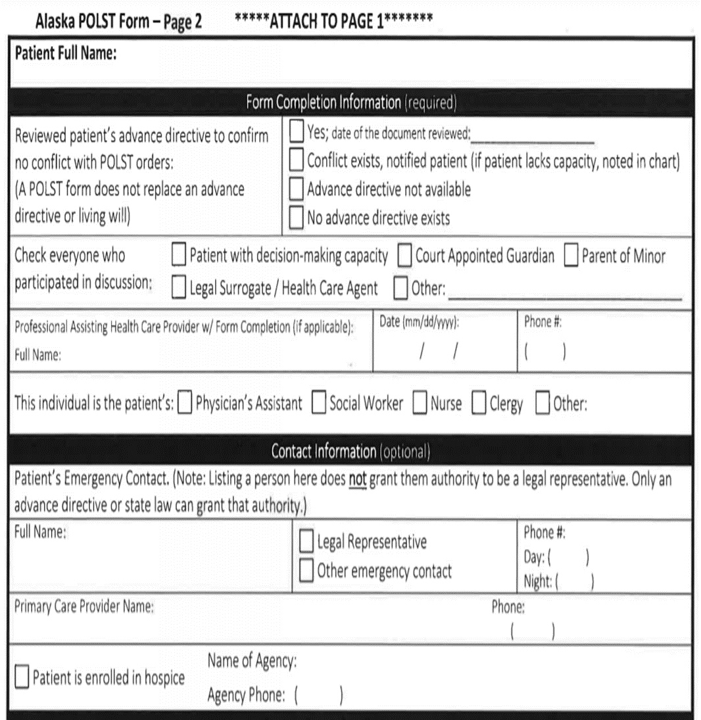
HIGHLIGHTS OF THE ALASKA POLST FORM
Form completion information:
Confirms that process involved:
Consideration of prior advance directives
Involvement of the person’s chosen agents, advocates, or surrogates
Identifies members of healthcare team who assisted in conversation/completion
Contact Information:
Confirms names/contact information for support people
Surrogate Decision maker or health care agent (by DPOA) should be listed here
Confirm agency name /contact if person is enrolled in hospice
NOTE: POLST cannot assign powers-of-attorney: this must be done in separate durable power of attorney form.
ANP,DNP
Practitioner
Notes:
Makes It clear who, what information was included,
All this is backed by law in statuts
Not verbal order ok. Meaning that ANP, PA who is admitting person, talking to MD, can sign tthat a verbal order was received.
Have a policy for this.

Slide 16
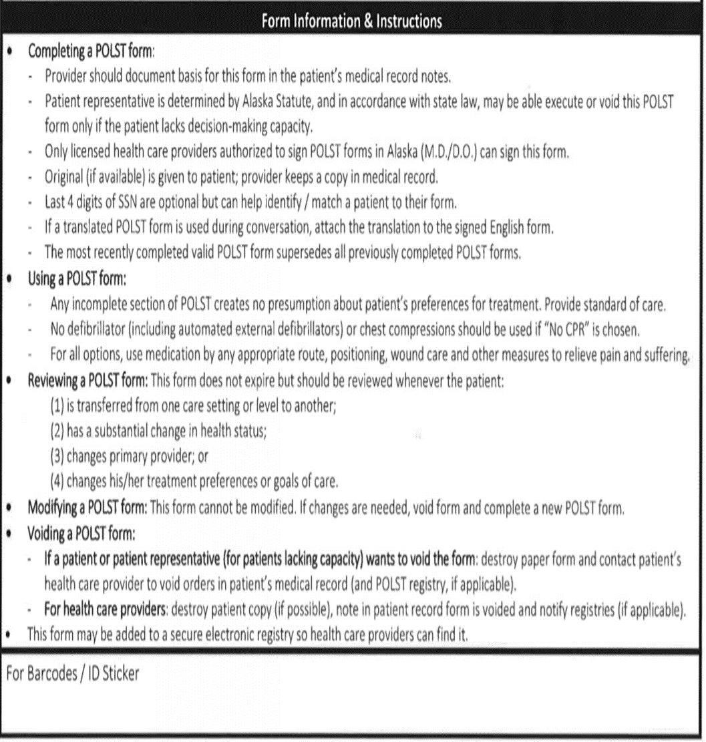
HIGHLIGHTS OF THE ALASKA POLST FORM
Instructions for:
Completing POLST
Honoring/using POLST
Reviewing POLST
Modifying or voiding POLST
NOTE:
POLST contains medical orders
Transfer to internal orders
Keep internal orders consistent with POLST (if new/changed)
Notes:
Please READ!

Slide 17
Life expectancy –
Would you be surprised if this individual died in the next 1-2 years?
Would this person be potentially harmed by, or their overall condition worsened by, aggressive, invasive measures
Increased risk of harm
Medical conditional
Personal values; preferences
WHO SHOULD BE CONSIDERED FOR A POLST?
Notes:
Ask the surprise question.
Mostly consider clinical…but you know this avout yyour residents..
Shared-Decision

Slide 18
SERIOUS AND CHRONIC
PROGRESSIVE ILLNESS
These numbers increase to 9 out of 10 in people over 80 years of age

Slide 19
WHO CAN FILL OUT A POLST FORM IF
THE PATIENT LACKS CAPACITY?
WE CAN HELP WITH THESE
parent
Notes:
Durable Power of Attorney for HealthCare:
This document assigns health-care decision making authority to person’s chosen agent.
Can only be appointed by the individual.
Most legal/BEST way to choose agent
If no documents exist, individual can name a “trusted decision maker” (TDM) verbally to a health care provider.
If neither of these exist, follow the hierarchy in state statute re: who can act as surrogate
Important for people to understand what happens when surrogacy is assigned from the hierarchy without an active choice by the individual:
All members of one class must either:
Vote on who will make decisions
Make decisions by consensus (or majority rule if unable to come to consensus)
Guardians may offer a non-objection to the physician’s recommendation (assent or non-opposition) : formal ‘non-opposition letter”

Slide 20
Alaska law requires all healthcare professionals to follow POLST Orders
WHO CAN (MUST) HONOR POLST?
All health care professionals
(includes EMT’s, first responders, and health care providers and clinicians in all settings):
Shall comply with POLST orders
Must honor the completed POLST form
Be provided immunity from civil or criminal liability
Covers how to handle disputes
Notes:
Patients or surrogates can modify or void a POLST form
If dispute arises regarding existing treatment orders on a POLST:
EMS: clarify understanding and contact On-Line Medical Control. If conflict continues to exist, transport to a hospital where there is more time to address conflict
Health Care Facilities and Organizations: follow your policy regarding surrogate/health care decision-making

Slide 21
TRANSITION TO POLST: COMFORT ONE TO POLST
The transition will benefit patients
Combines the function of Comfort One and some in-facility orders, such as MOST.
Applicable to more patients (Comfort One primarily created for hospice.)
Ensures patients receive their desired level of care
not just in CODE situations (protects against unwanted care.)
Legal protections and protocols for portability, state-wide: EMS, Long-term care facilities, Hospitals.
A POLST form is an active medical order to be followed by EMS and all health care professionals in all settings.
Notes:
*AHCDA: Included “Do not resuscitate protocol and identification requirements”: A physician may issue a DNR order for a patient, DHSS shall by regulation adopt a protocol, approved by State Medical Board, for the DNR orders, and set standardization of the form and procedure for withholding CPR required by all health care providers.
DHSS decision:
1) EMS will continue to honor Comfort One (always) when presented (indefinitely)
2) Comfort One will be available for the next 6 months. Running in parallel for 6 months.
Most recently written order will be active order.
Comfort One was faxed and kept on file at dispatch/ fire dept office.
Recommendation:
-- that POLST be kept with patient and presented to EMS with EACH encounter.
Facilities will need protocol to find/present {POLST).
--POLST should be faxed to patient’s primary hospital
This will make things simpler:
No longer have to order forms from the state. No triplicates, no notifications
AK POLST will always

Slide 22
TRANSITION TO POLST: MOST TO POLST
Background on MOST:
Designed by a state task force for potential use statewide
Adopted by LTC facilities across the state as an active medical order in a facility
Used as a communication tool
Creates orders that :
Are not transferable; cannot “follow” patient to different settings (hospital, home)
May be signed by a provider (NP, PA) whose orders cannot be followed by EMS or any subsequent site of care.
Unfortunately, this was never passed into law…

Slide 23
TRANSITION TO POLST: MOST TO POLST
Recommendations of DHSS POLST Workgroup:
Alaska POLST is to be recognized as statewide transferable orders.
Avoid confusion between MOST and POLST!
Because the MOST looks Alaska POLST, it is advised: Alaska POLST should replace MOST in skilled and long-term care facilities.
Alternately,
Transfer orders from POLST to in-facility orders for: Code Status, Antibiotics, Level of Care, Medical, Nutrition/hydration.
Rebrand MOST with facility name: Do NOT use as “Alaska MOST”.
Develop policy for using POLST with in-facility orders.
May continue to need policy for people who opt NOT to have a POLST.
Be CLEAR: If a person wants DNR that will be valid during and after transport, they will want/need to have a POLST!!
Notes:
You can encourage POLST by:
--Be on the look-out for Comfort One—
--Introduce POLST to pt/ NpPA can get verbal orders from PCP
--fax to PCP, or does medical director take responsibility
“Does everyone who needs to know, about it get the word.
Pay attention to hand-offs.

Slide 24
Consider
ADVANCE CARE PLANNING/
POLST FOR HEALTH CARE FACILITIES
Process: Policies and Procedures
Training: Skills, documentation
Regular review and confirmation
Ensure clarity and access
Notes:
Barb/ Karen: Sample policies
Refer to samples from other states on the website.
If anyone would like to join the LTC POLST work/sub-group!! Please let us know.
Barb/ Karen: Sample policies
Refer to samples from other states on the website.
If anyone would like to join the LTC POLST work/sub-group!! Please let us know.
Create /review policies and procedures:
how your facility will incorporate ACP into care plans
Training expectations for staff
Policies for introducing, assisting with, and honoring POLST and AD
Consider having a policy for Trusted Decision Makers (TDM)*
Ensure staff is competent in assisting with advance care planning
Involve resident, healthcare agent/surrogate, other trusted advocates
Know when to recommend/offer POLST
Involve primary health care team
Remember MD/DO must sign POLSTDiscuss prior wishes, advance directives, POLST with
every admission/change in status
in quarterly /annual conferences.
Know when to offer POLST; communicate with health care provider when appropriate.
Check that orders, including POLST, are consistent with the person’s known values/ priorities, and with other ACP documents.
Keep POLST and other ACP documents together and easily accessible in an emergency.
Send original POLST (and other documents) with individual if transfer is necessary.

Slide 25
POLST is part of advance care planning (ACP).
All advance care planning is voluntary on the part of the patient.
Provide information, support and assistance with ACP.
Include prior discussions, documents, update all
Ensure that POLST choices “make sense”
E.g. “Yes to CPR” is matched with Full treatment in Section B
Ensure POLST is accessible across settings.
Create policies regarding, and train all personnel in assisting with, recording/storing, and accessing POLST.
BEST
PRACTICES

Slide 26
TAKEAWAY TIPS
If there is a prior POLST, don’t start over!
Review decisions, confirm if no changes and make note with new date on POLST.
Include health care agents, trusted decision makers or surrogates whenever possible.
Family/surrogates will appreciate having “heard it from the patient”
Photocopies are legal and valid; everyone involved with patient should have one.
Hand them out ”like candy”
Everyone needs an Advance Directive:
most important is naming an agent.
Not everyone needs a POLST, but MANY people in SNF/LTC probably should have one!
Think POLST for individuals with: serious illness, progressive decline, frailty.
If patient wants to be ”full code”, they don’t need a POLST*
Notes:
If full code, indicate in facility orders, not POLST
Full code defaults into ”standard of care”. POLST only if they want to opt out of SOC
*note exceptions!!

Slide 27
akpolst.org
Notes:
Join us for the next webinar,
Consider joinging the team,
Submit questions to XXXX

